Slide 1

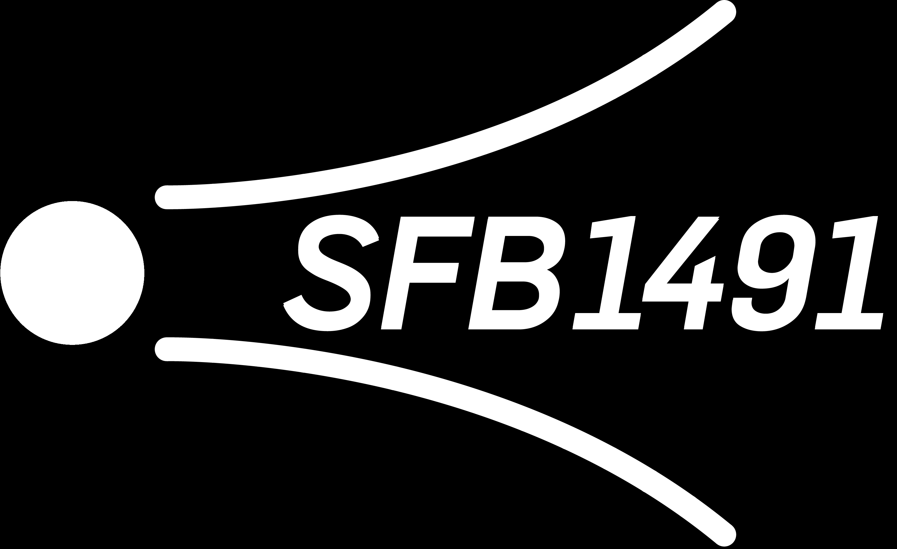
Muon flux unfolding: update on systematics Pascal Gutjahr
February 7, 2025
WG reviewer: Dennis Soldin
Technical reviewer: Karolin Hymon
Wiki: prompt wiki
Last update: madison_talk
CR-Call
Source: NASA

Slide 2

Analysis Goals: Detect Prompt Muons
Unfold a muon energy spectrum at surface
Measure prompt component of the atmospheric muon flux
Most energetic muon in bundle
Muon parent:
pion or kaon
yes
no
conventional
prompt
Credit: Ludwig Neste

Slide 3
Overview
Analysis
Simulation
Reconstruction
Selection
Forward fit
Dataset
CORSIKA 77500 Ehist
SIBYLL 2.3d
10 TeV – 100 EeV
DNN reconstructions
Muon energies
Muon direction
Track geometry
Level 3
L2 muon filter
500 TeV bundle energy cut at surface
Add labels
Fit prompt normalization
Poisson LLH fit
Validation
Tag prompt / conv particles
MCEq comparisons
Unfolding
Level 4
Add DNN reconstructions
Muon spectrum
Unfold muon flux
Level 5
Data-MC quality cuts

Slide 4
Unfolding

Slide 5
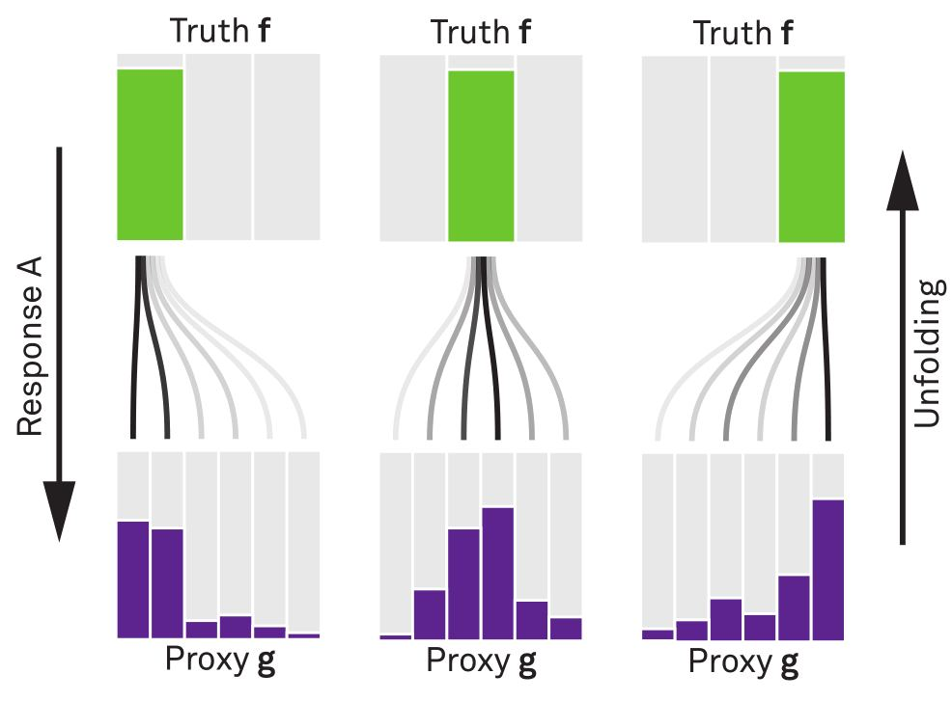


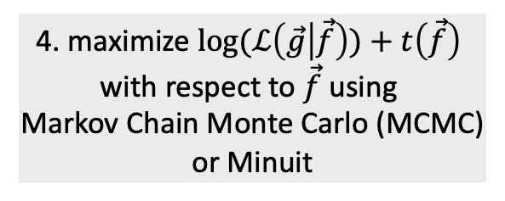
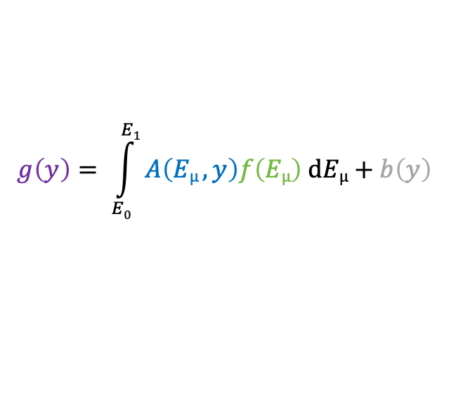
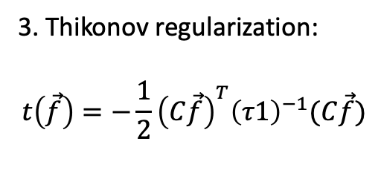
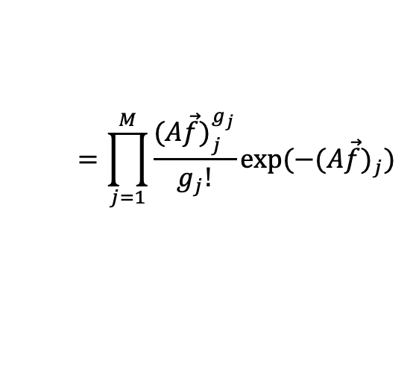
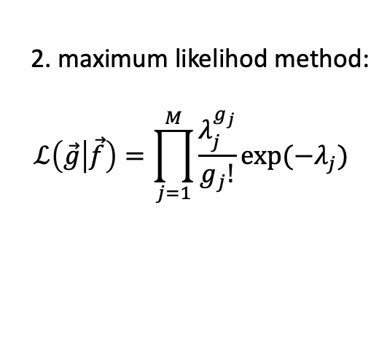
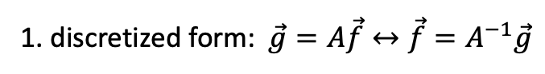
Unfolding in a nutshell
folding
unfolding
1. discretized form: $\vec{g}=A\vec{f}↔\vec{f}=A^{−1}\vec{g}$
measured proxy
detector response
background
$$g\left(y\right)= \int_{E0}^{E1}{A\left(Eµ , y\right)f\left(Eµ\right) dEµ+b\left(y\right) }$$
2. maximum likelihod method:
$$ℒ\left(\vec{g} | \vec{f}\right)=\prod_{j=1}^{M}{\frac{λ_{j}^{g_{j}}}{g_{j}!}exp⁡(−λ_{j})}$$
3. Thikonov regularization:
$$t\left(\vec{f}\right)=−\frac{1}{2}{\left(C\vec{f}\right)}^{T}{\left(τ1\right)}^{−1}(C\vec{f})$$
true energy distribution
$$=\prod_{j=1}^{M}{\frac{{(A\vec{f})}_{j}^{g_{j}}}{g_{j}!}exp⁡(−{(A\vec{f})}_{j})}$$
funfolding
by M. Börner
4. maximize $log⁡(ℒ\left(\vec{g} | \vec{f}\right))+t\left(\vec{f}\right)$
with respect to $\vec{f}$ using
Markov Chain Monte Carlo (MCMC)
or Minuit
Credit: T. Hoinka

Slide 6
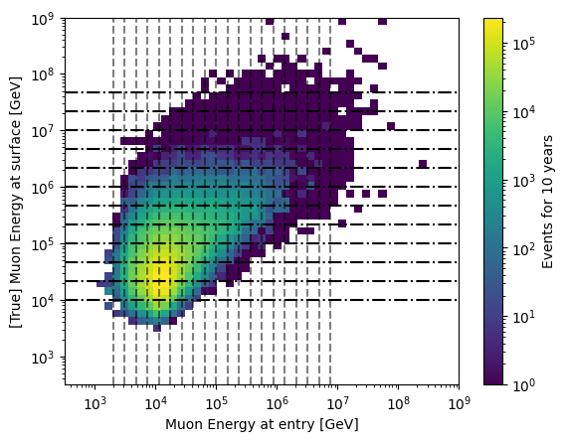
Proxy vs Target

Slide 7
Unfold Event Rate

Slide 8
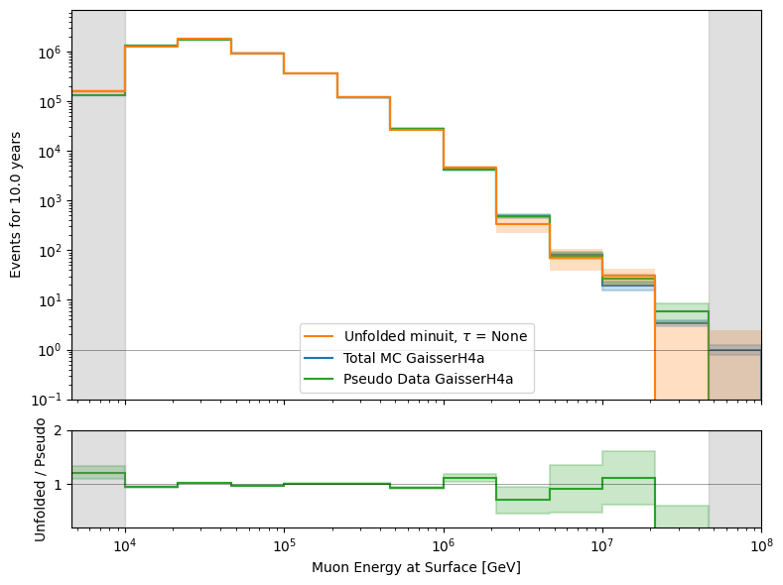
Event Rate

Slide 9
Unfold Muon Flux

Slide 10
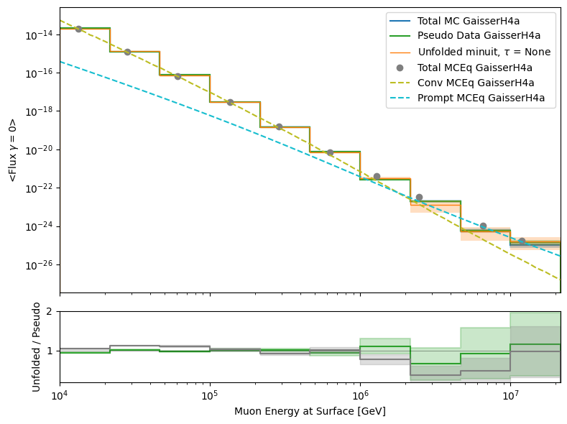
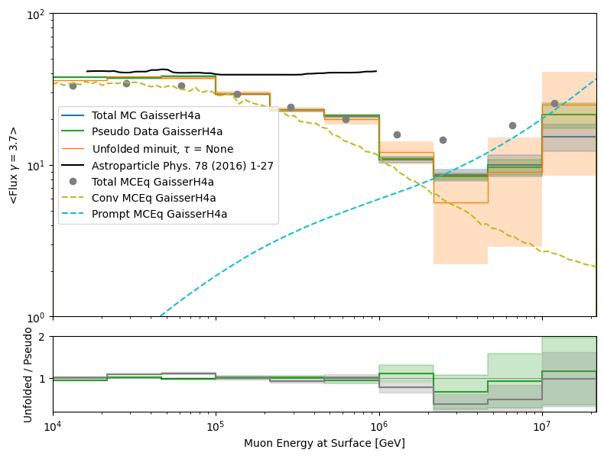
Muon Flux at Surface

Slide 11
Ice Systematics
Snowstorm
Scattering
Absorption
DOMEfficiency
Hole Ice Forward p0
Hole Ice Forward p1

Slide 12
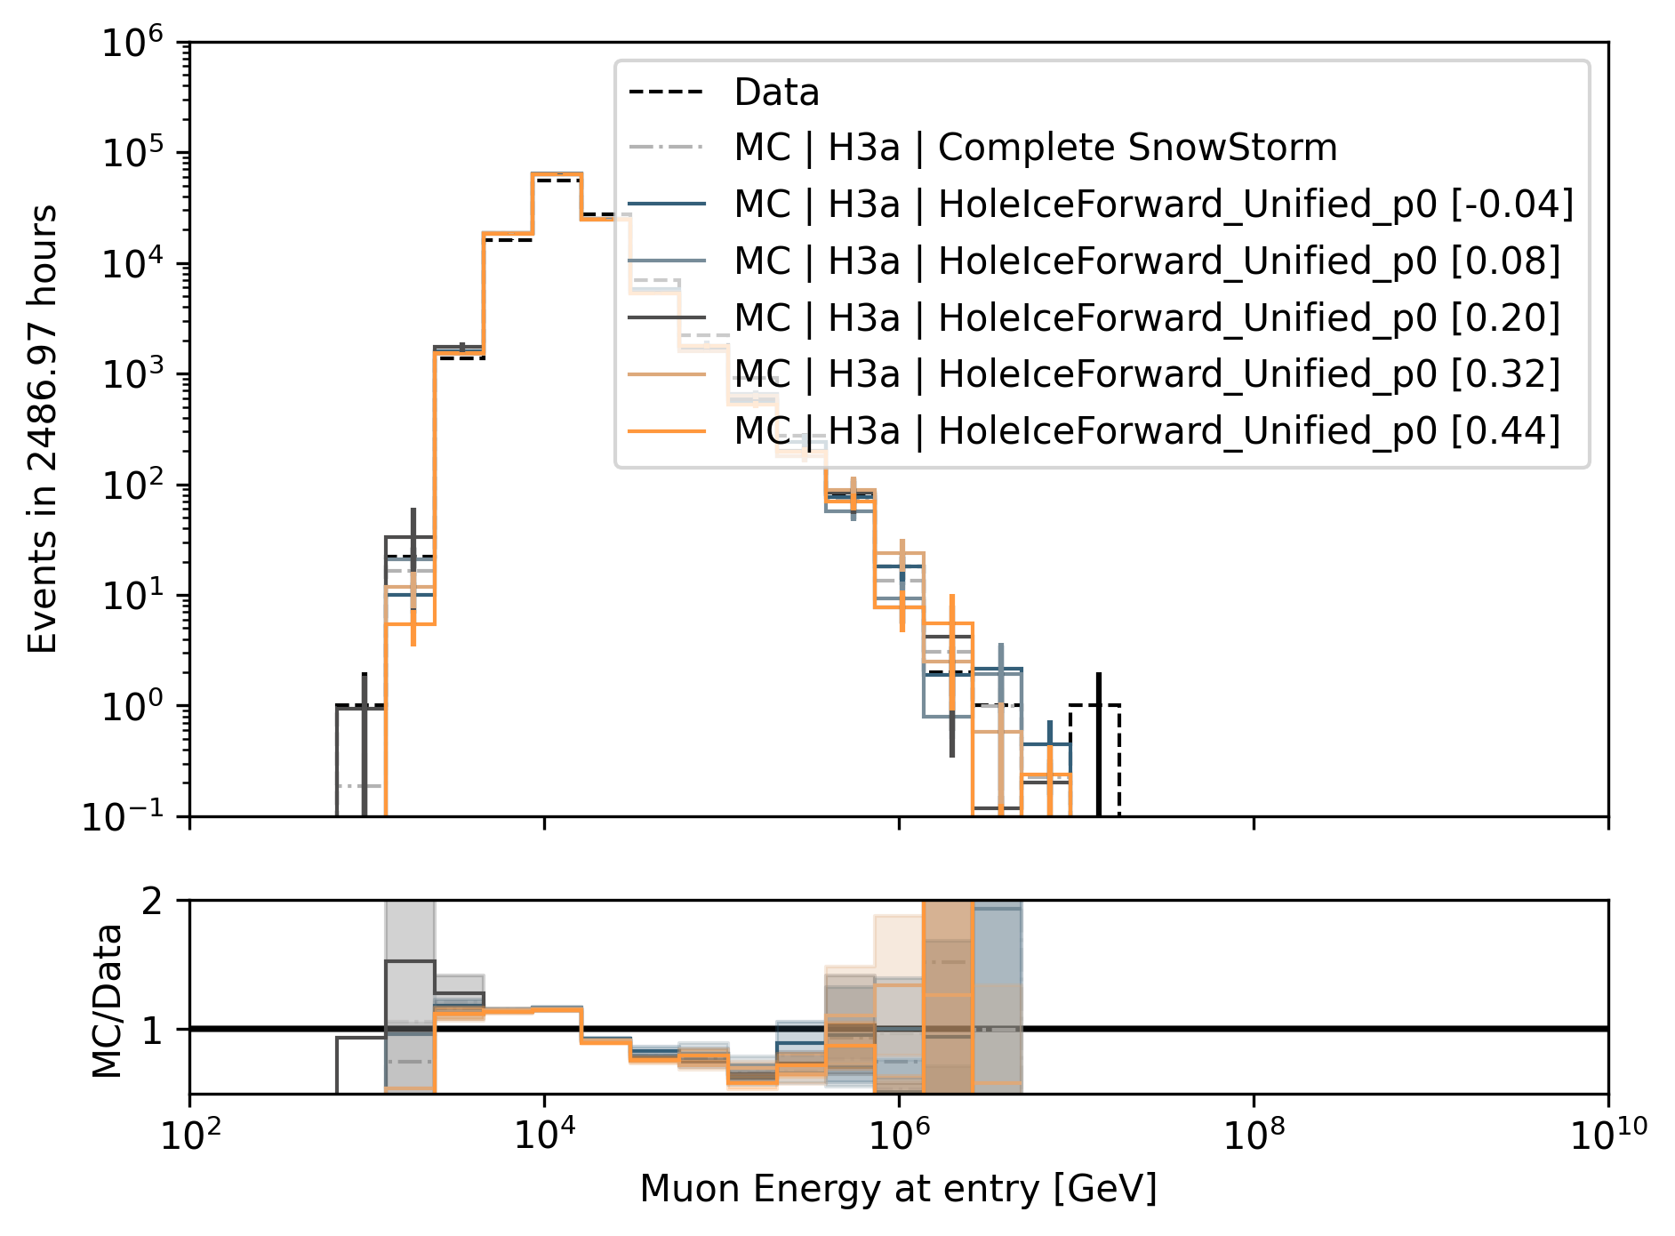
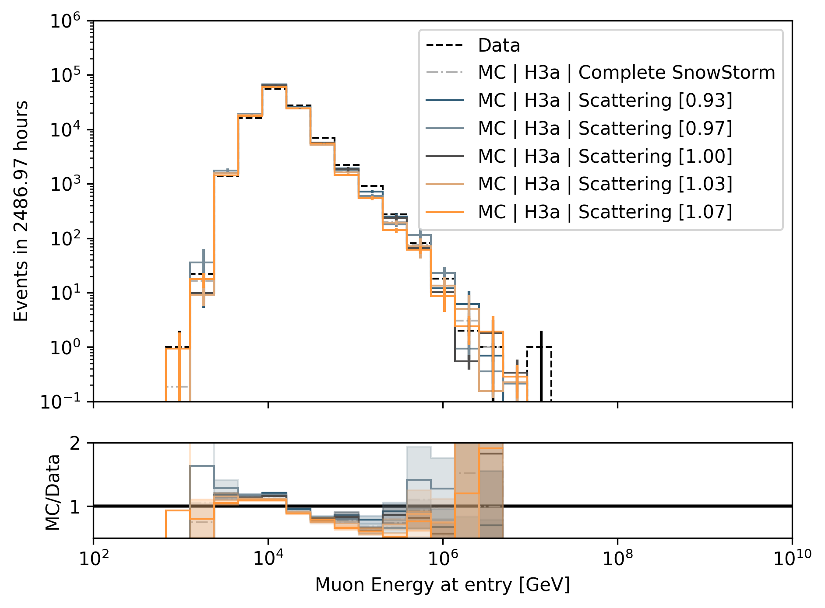
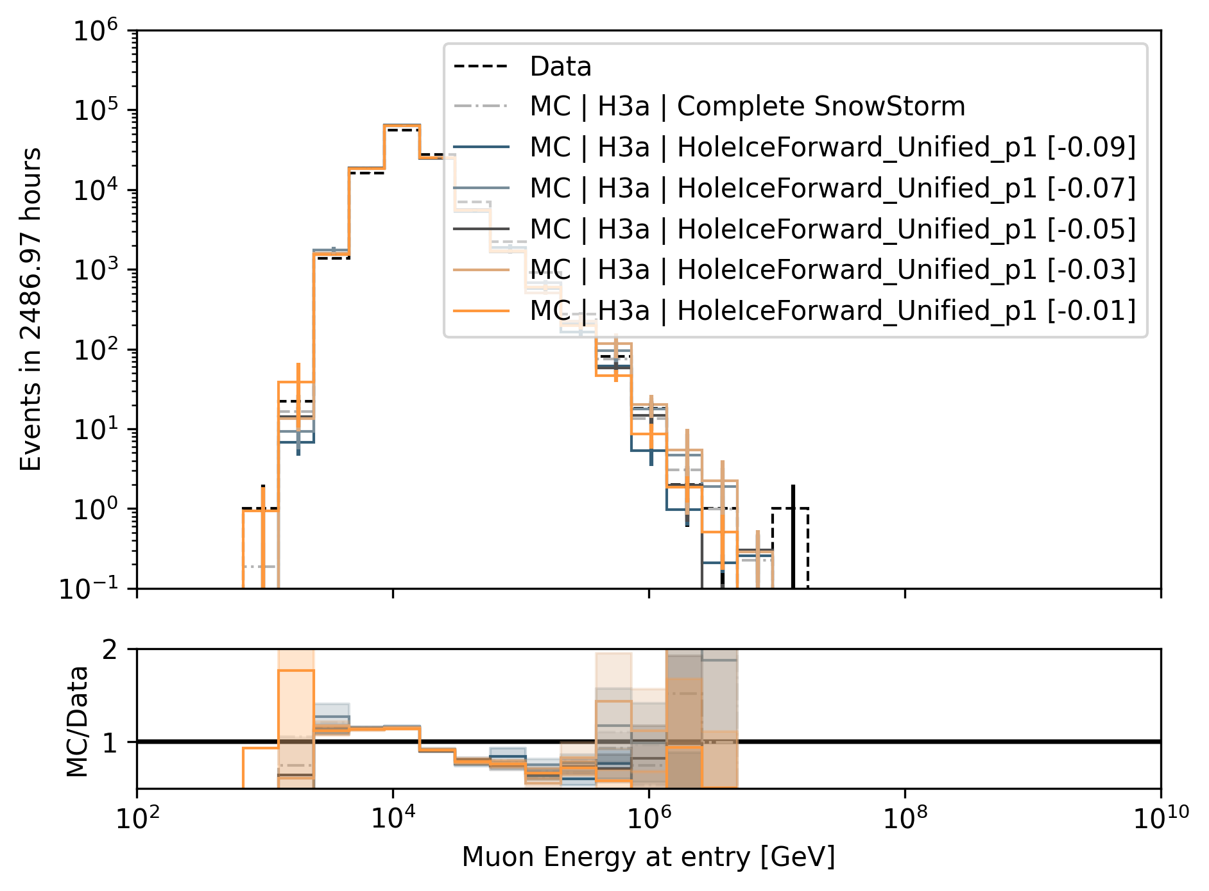
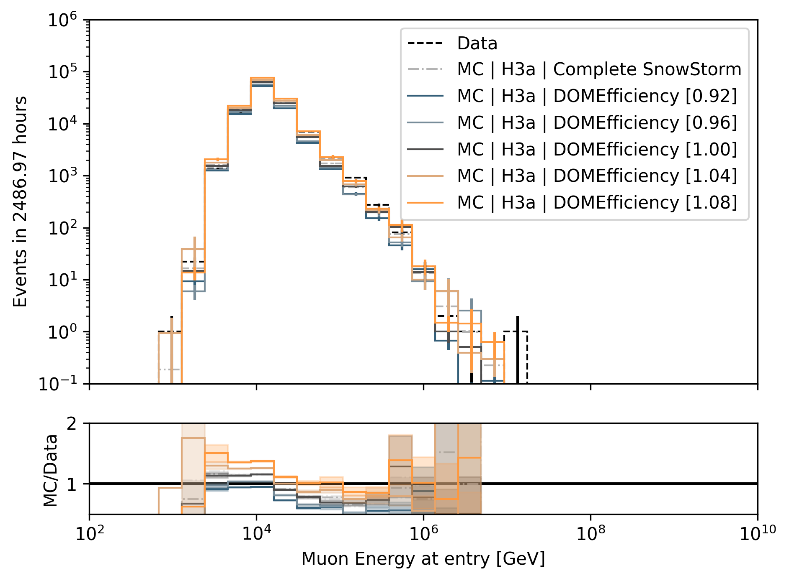
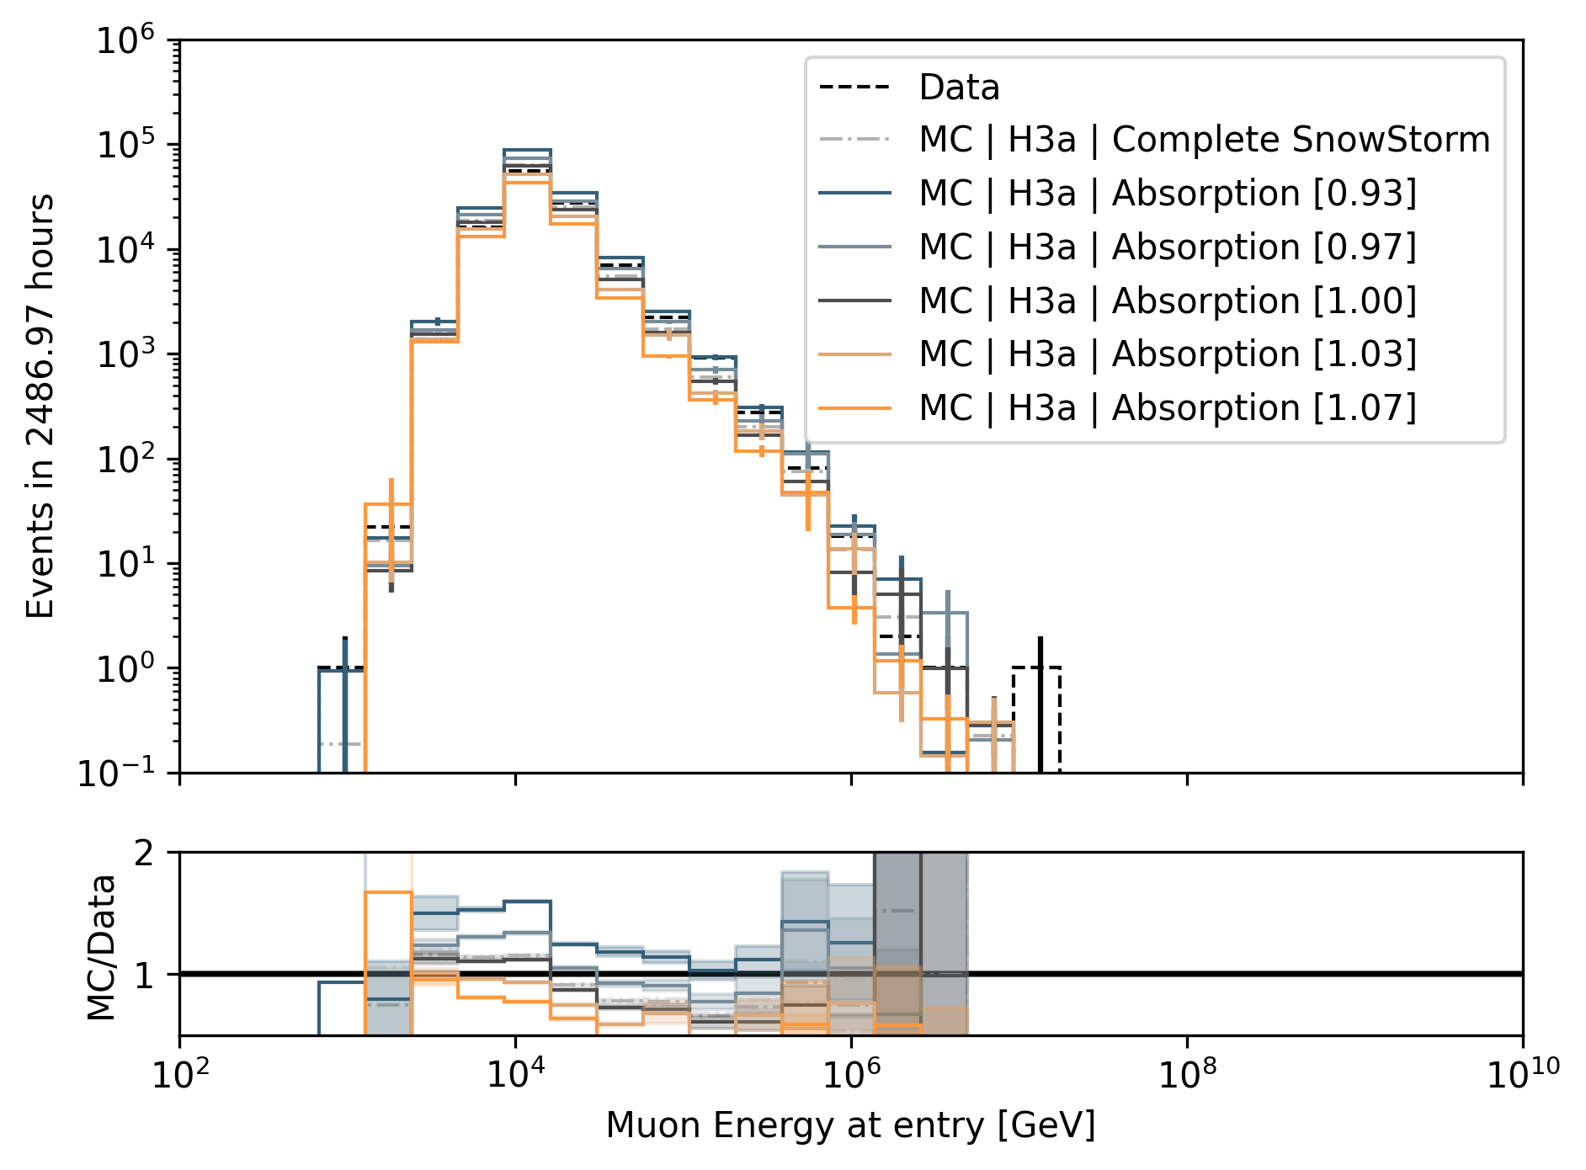
Systematics Impact on Muon Energy at Entry (Proxy)
HoleIce p0
Scattering
HoleIce p1
Divide systematic range into 5 equidistant bins
Largest impact by DOMEfficiency and Absorption
DOMEfficiency
Absorption

Slide 13
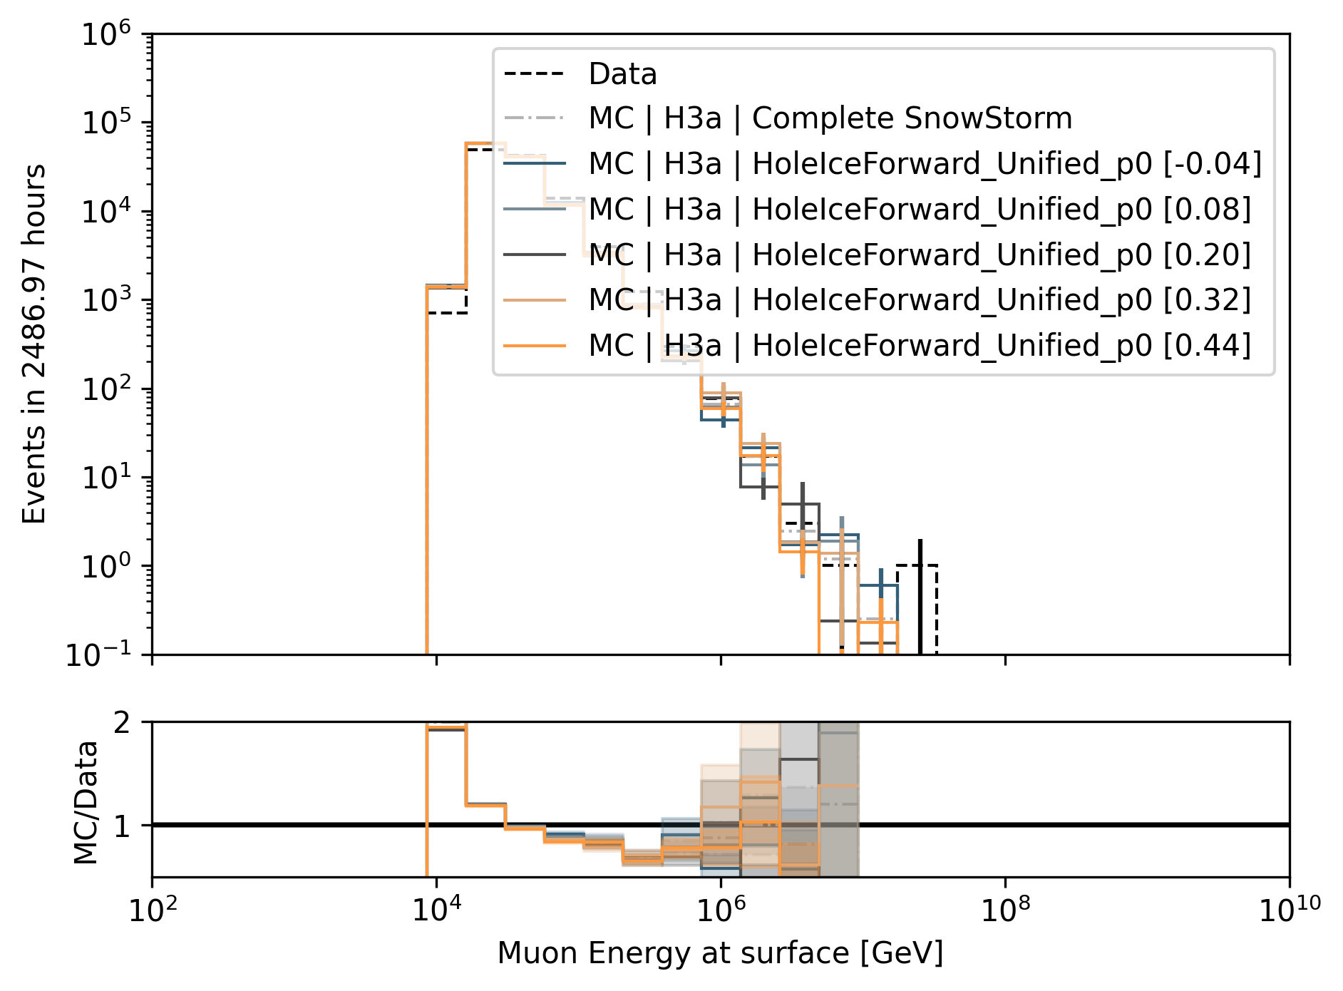
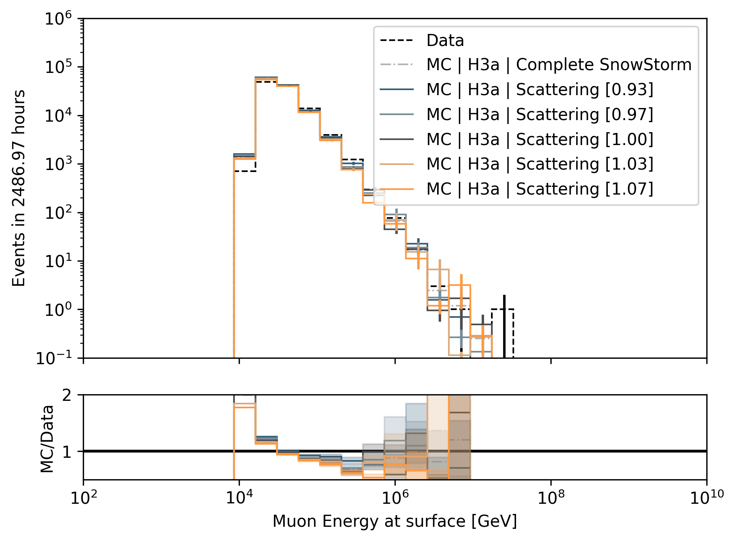
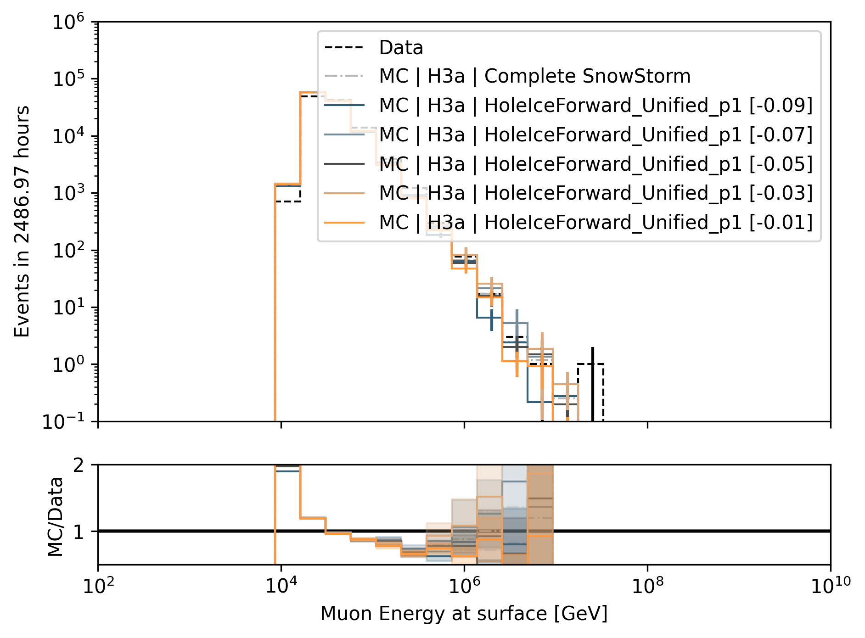
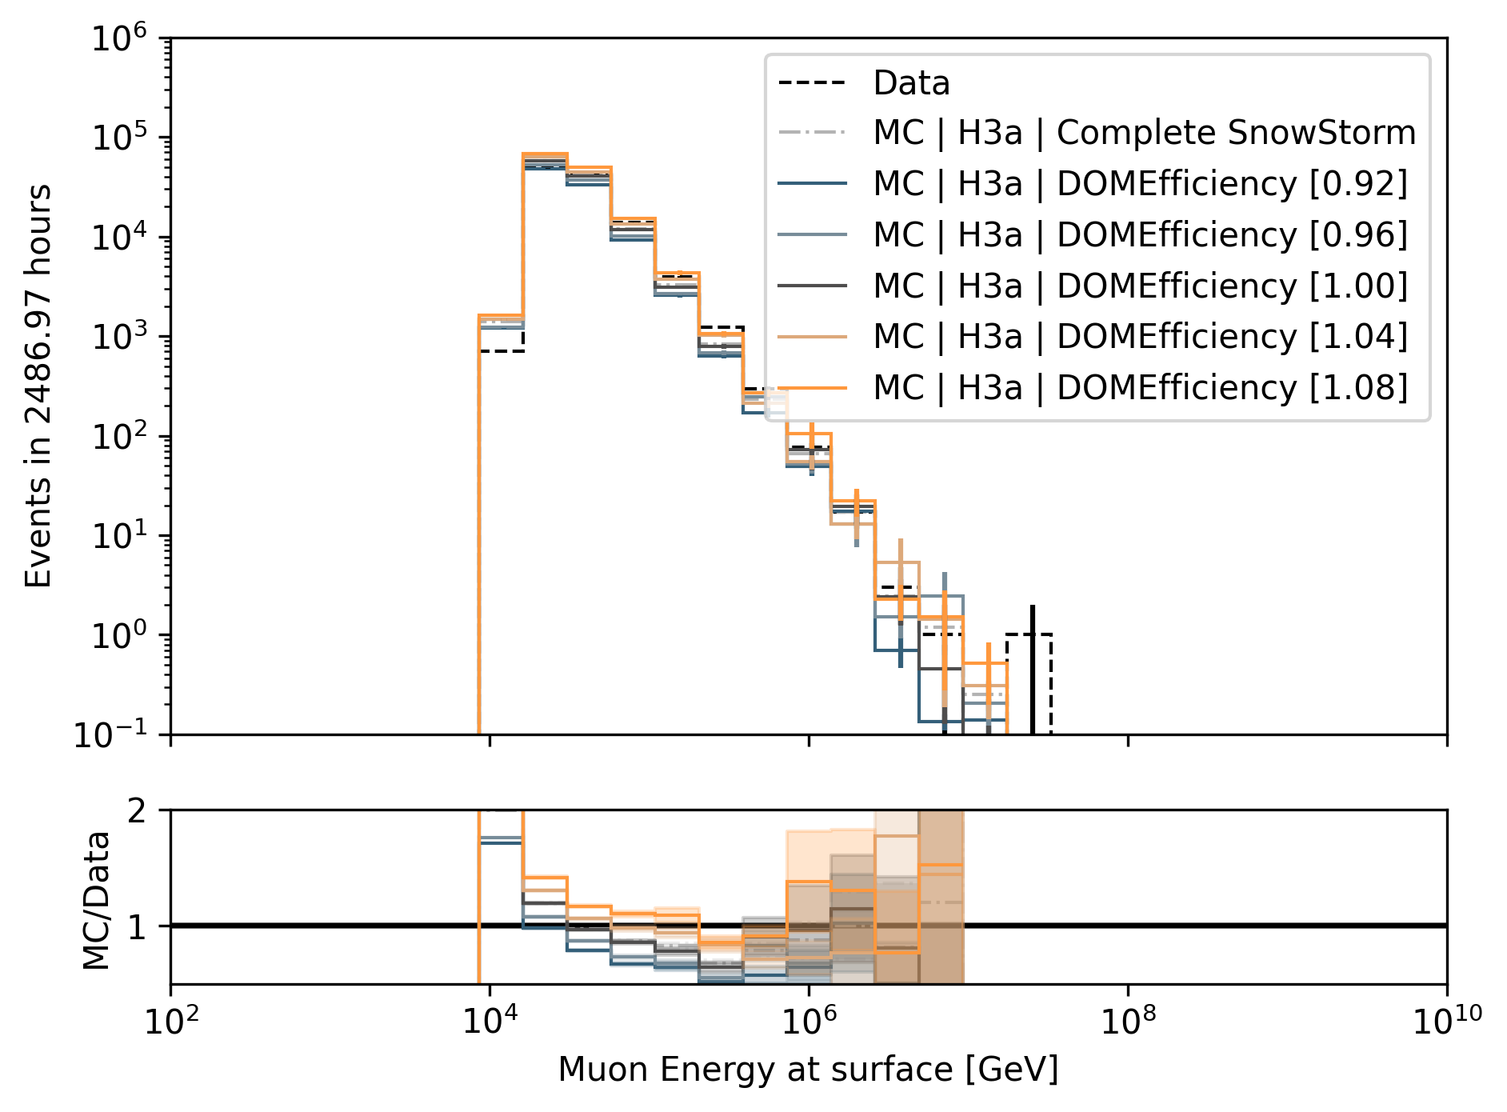
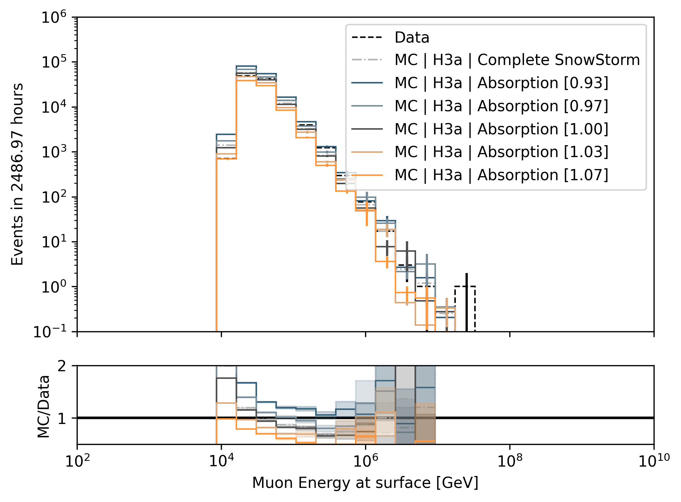
Systematics Impact on Muon Energy at Surface (Target)
HoleIce p0
Scattering
HoleIce p1
Divide systematic range into 5 equidistant bins
Largest impact by DOMEfficiency and Absorption
DOMEfficiency
Absorption

Slide 14
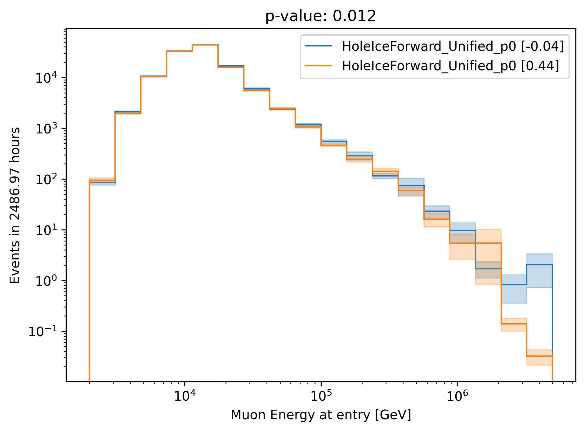
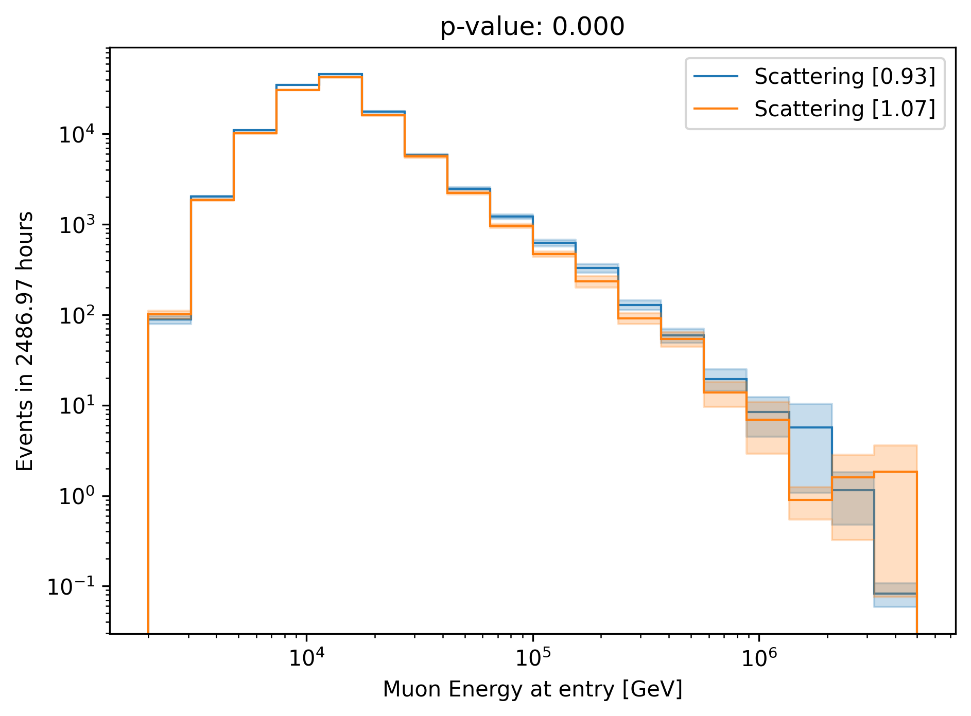
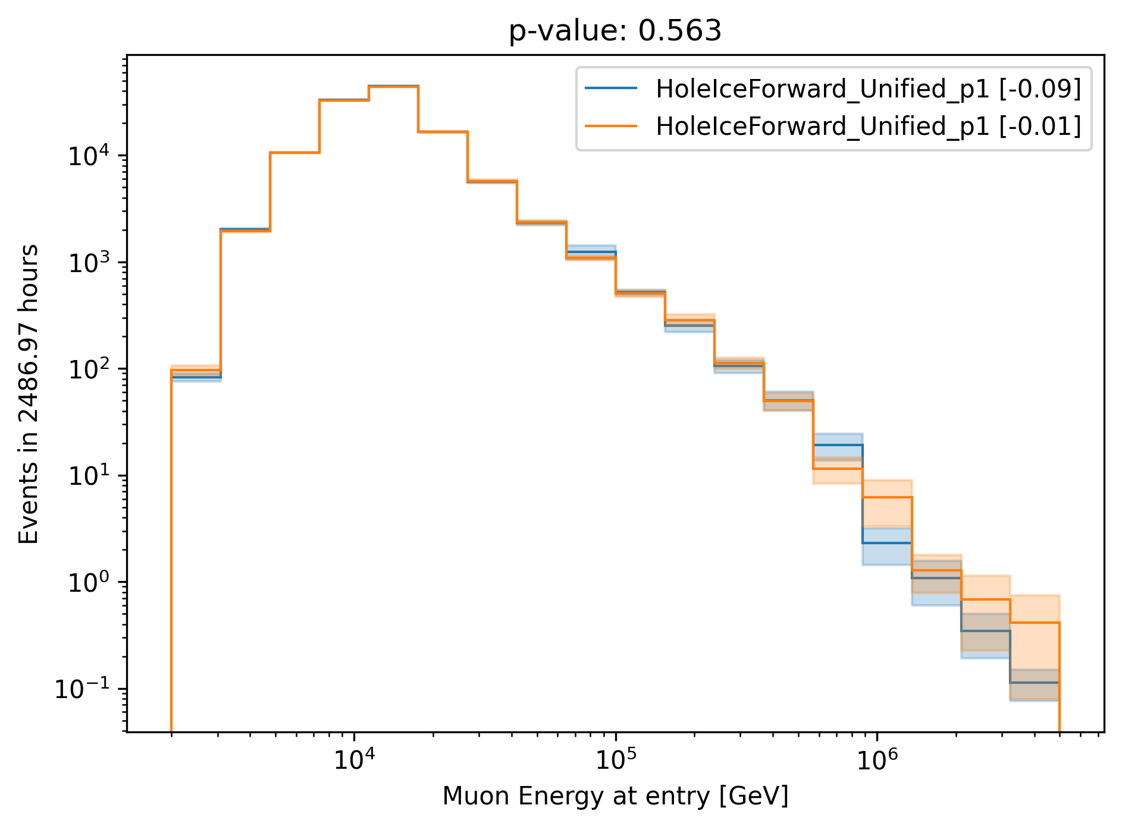
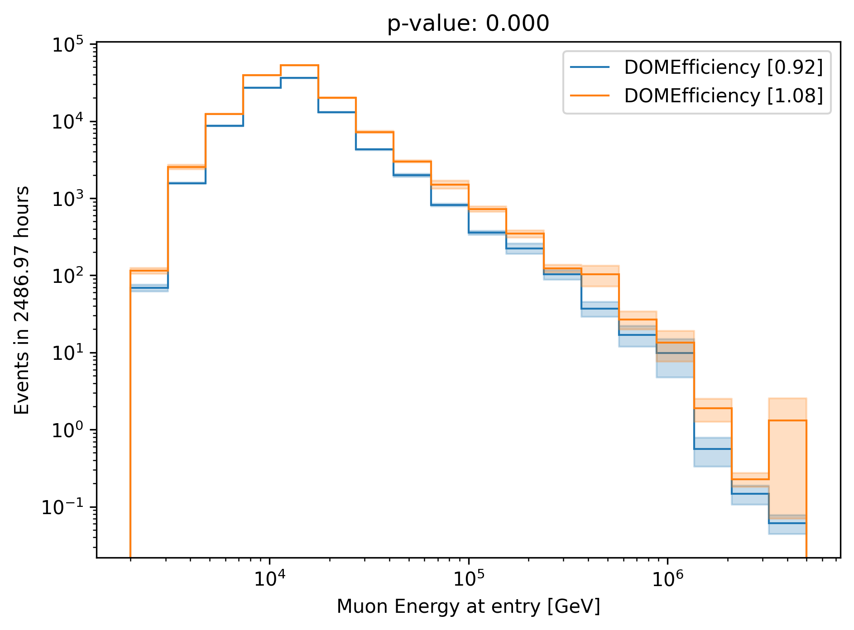
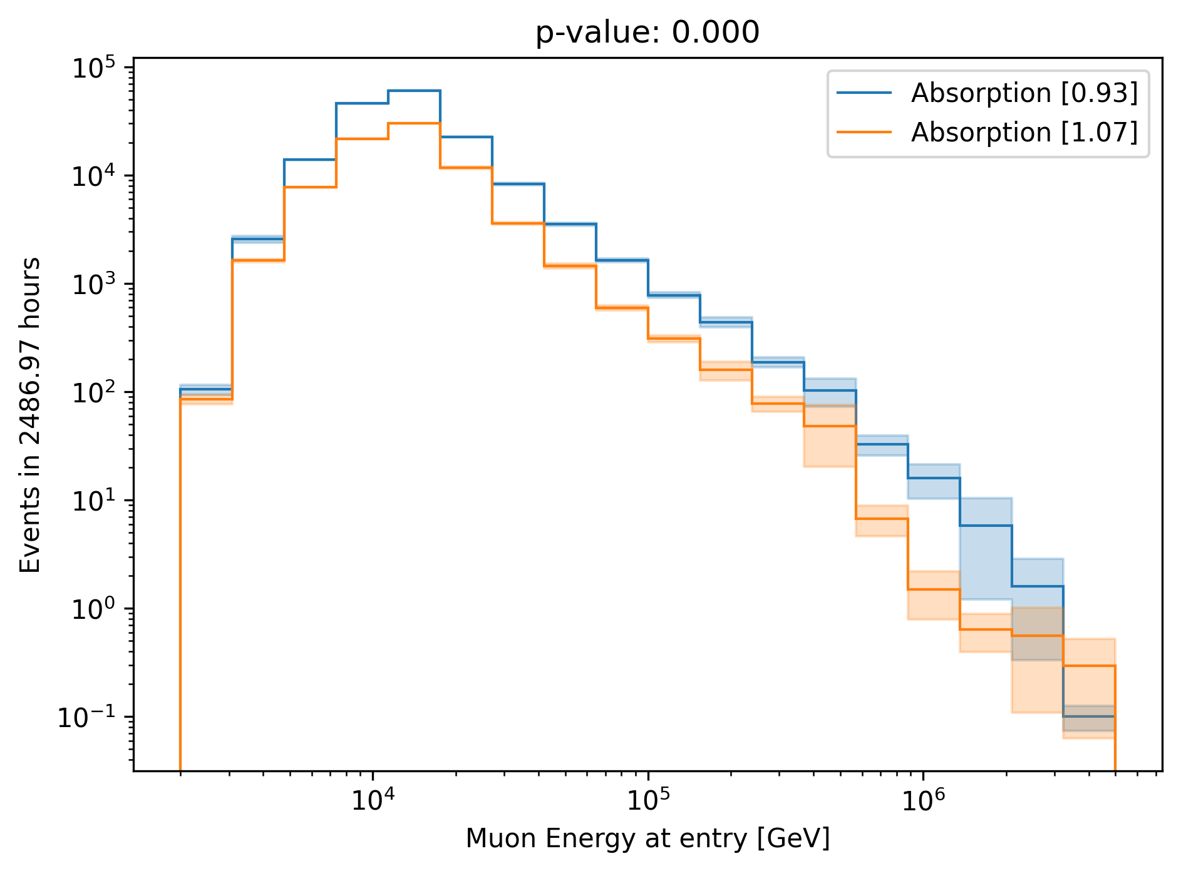
Chi2 Test: Muon Energy at Entry (Proxy)
HoleIce p0
Scattering
HoleIce p1
Chi2 test between lower and upper systematic range bin
No impact from Hole Ice p1
Small impact from Scattering and Hole Ice p0
DOMEfficiency
Absorption

Slide 15
Parameterize Systematics
Vary each systematic parameter for each proxy bin (18 proxy bins, 3 systematic bins)
Fit the relative change of the bin content
Chi2 test, if constant y = 1 is compatible with data points (p-value = 0.05)
Find linear fit with the lowest slope that is compatible with p-value = 0.2
Require fit is going through (center, 1)

Slide 16
Absorption

Slide 17
DOMEfficiency

Slide 18
Hole Ice p0 → not sensitive enough (same for Hole Ice p1)

Slide 19
Scattering

Slide 20
Unfold Muon Flux with Systematics
No regularization

Slide 21
Muon Flux at Surface (no regularization)

Slide 22
Unfold Muon Flux with Systematics
With regularization

Slide 23
Muon Flux at Surface (Tau = 0.001)

Slide 24
Systematic bins
Tau = None
Tau = 0.001
underflow bin
Regularization minimizes the correlation
Find tau with the minimum correlation
overflow bin

Slide 25
Conclusion
Unfold muon event rate ✅
Unfold muon flux at surface ✅
Parameterize ice systematics ✅
Small impact from Scattering, Hole Ice p0 , and Hole Ice p1
Linear parameterization of Absorption and DOMEfficiency
Unfold muon flux with systematics ✅
Next steps
Test impact of different primary models (spectral index)
Choose optimal regularization

Slide 26
Backup

Slide 27
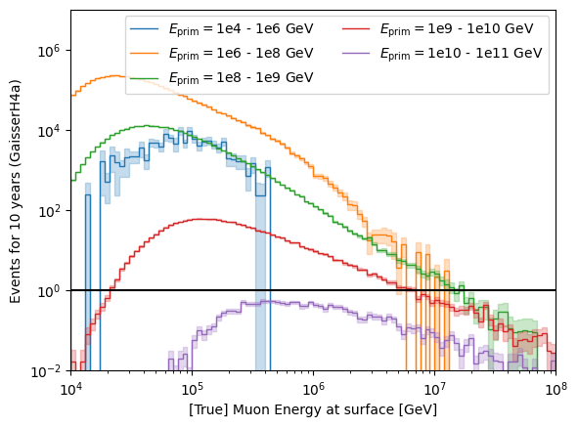
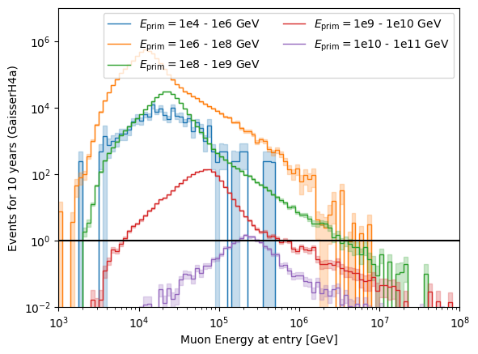
Relation between primary energy and muon energy at surface and entry

Slide 28
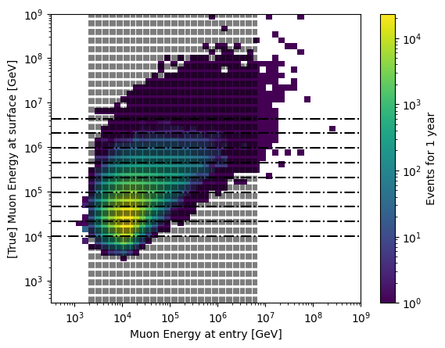
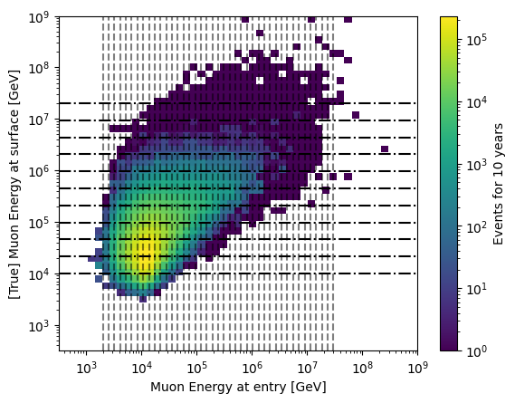
Proxy vs. target
1 year
10 years

Slide 29
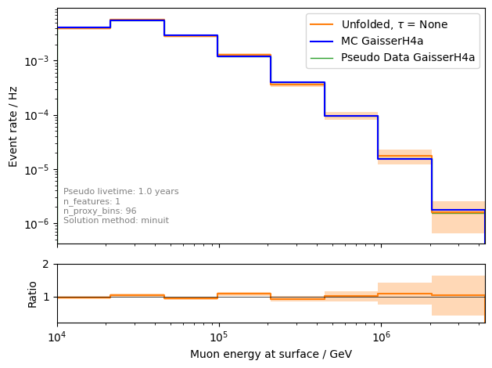
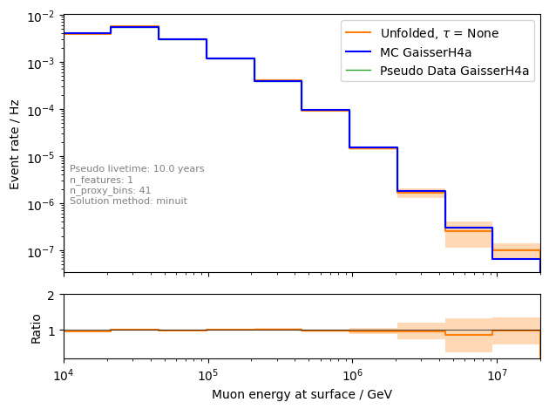
Unfolding event rate
1 year
10 years

Slide 30
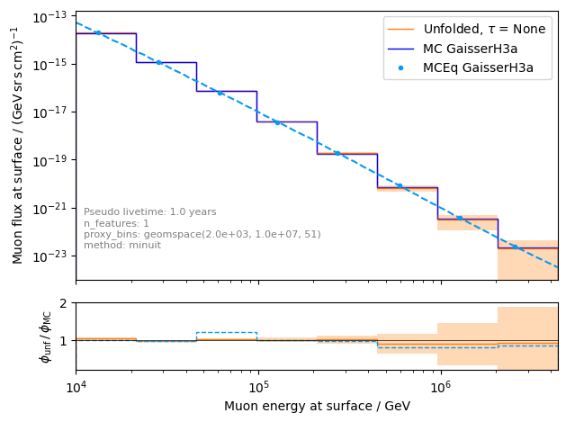
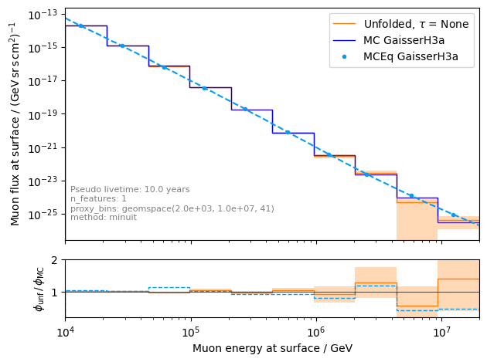
unfolding of muon flux at surface
1 year
10 years

Slide 31
Ice systematics
Snowstorm
Absorption
Scattering
DOMEfficiency
HoleIce 0
HoleIce 1

Slide 32
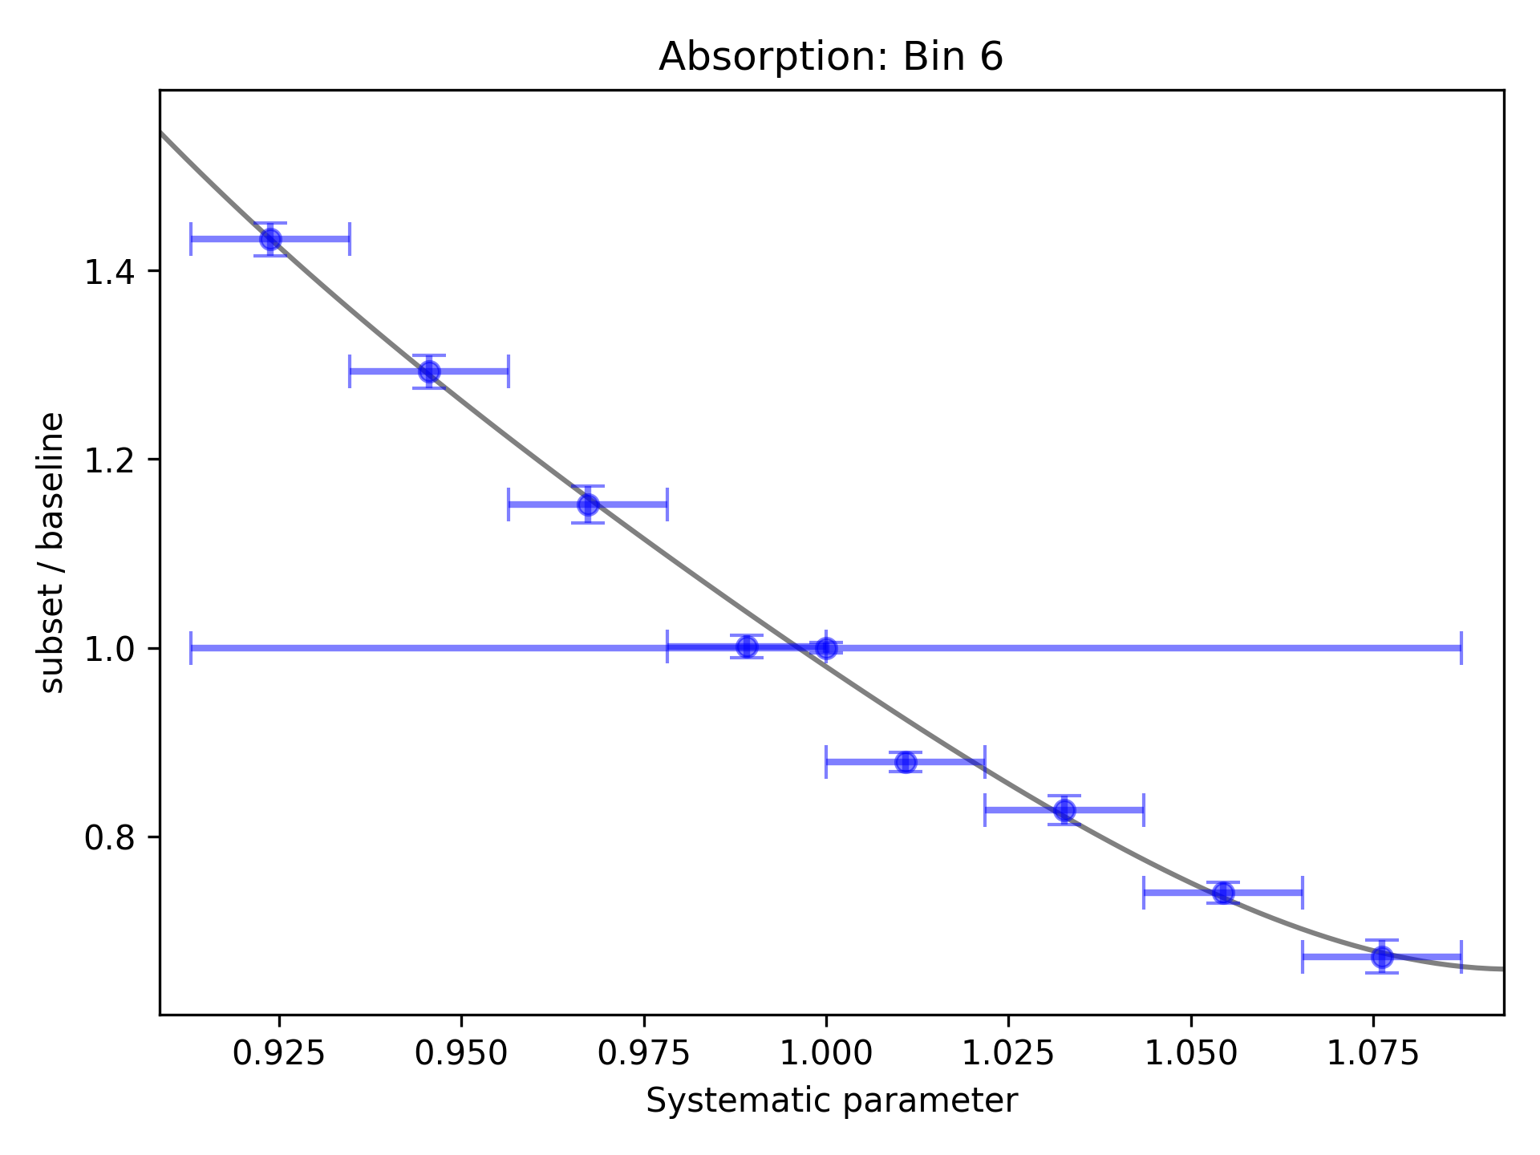
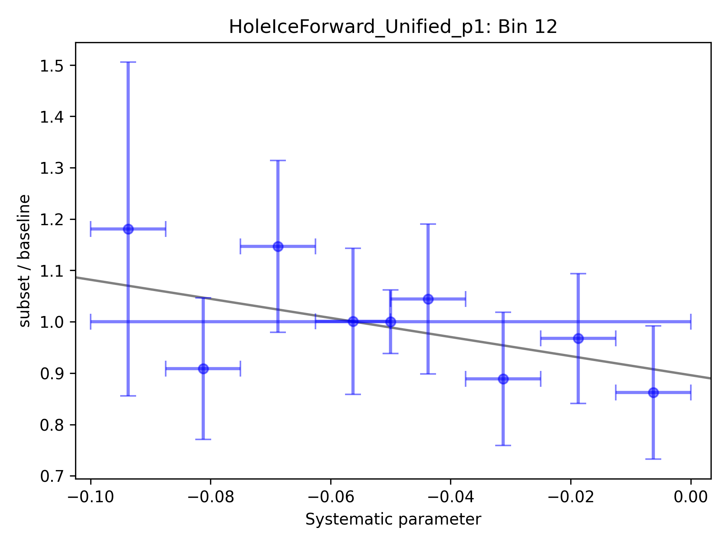
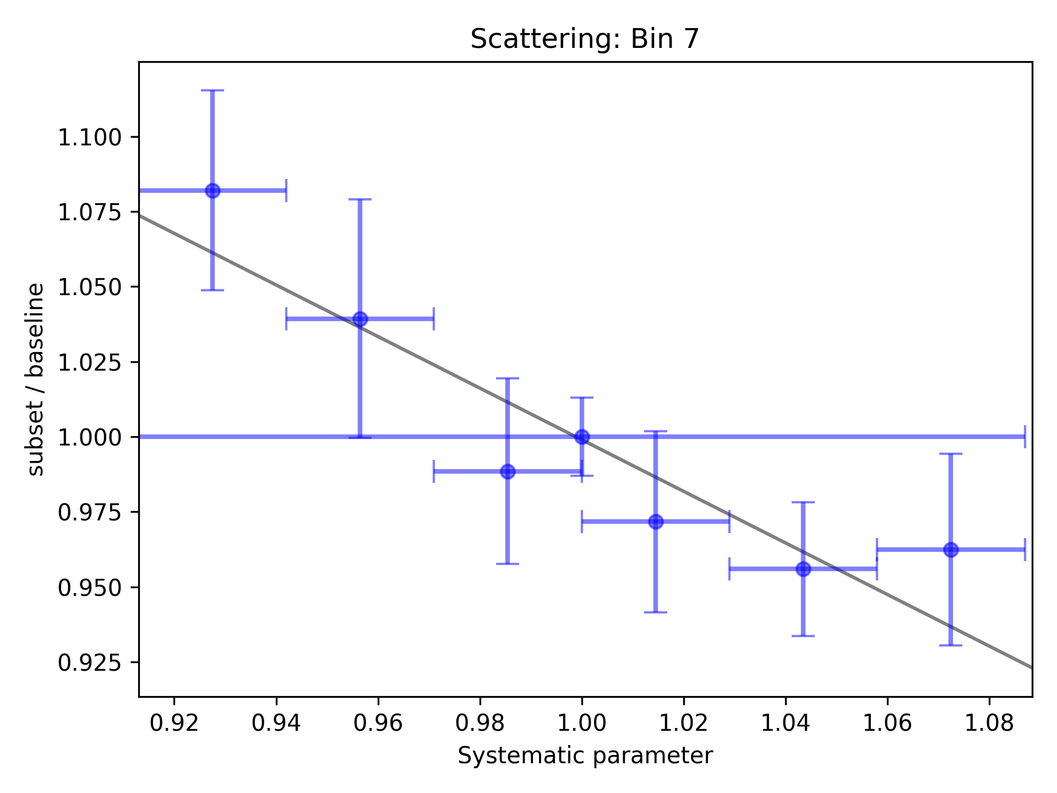
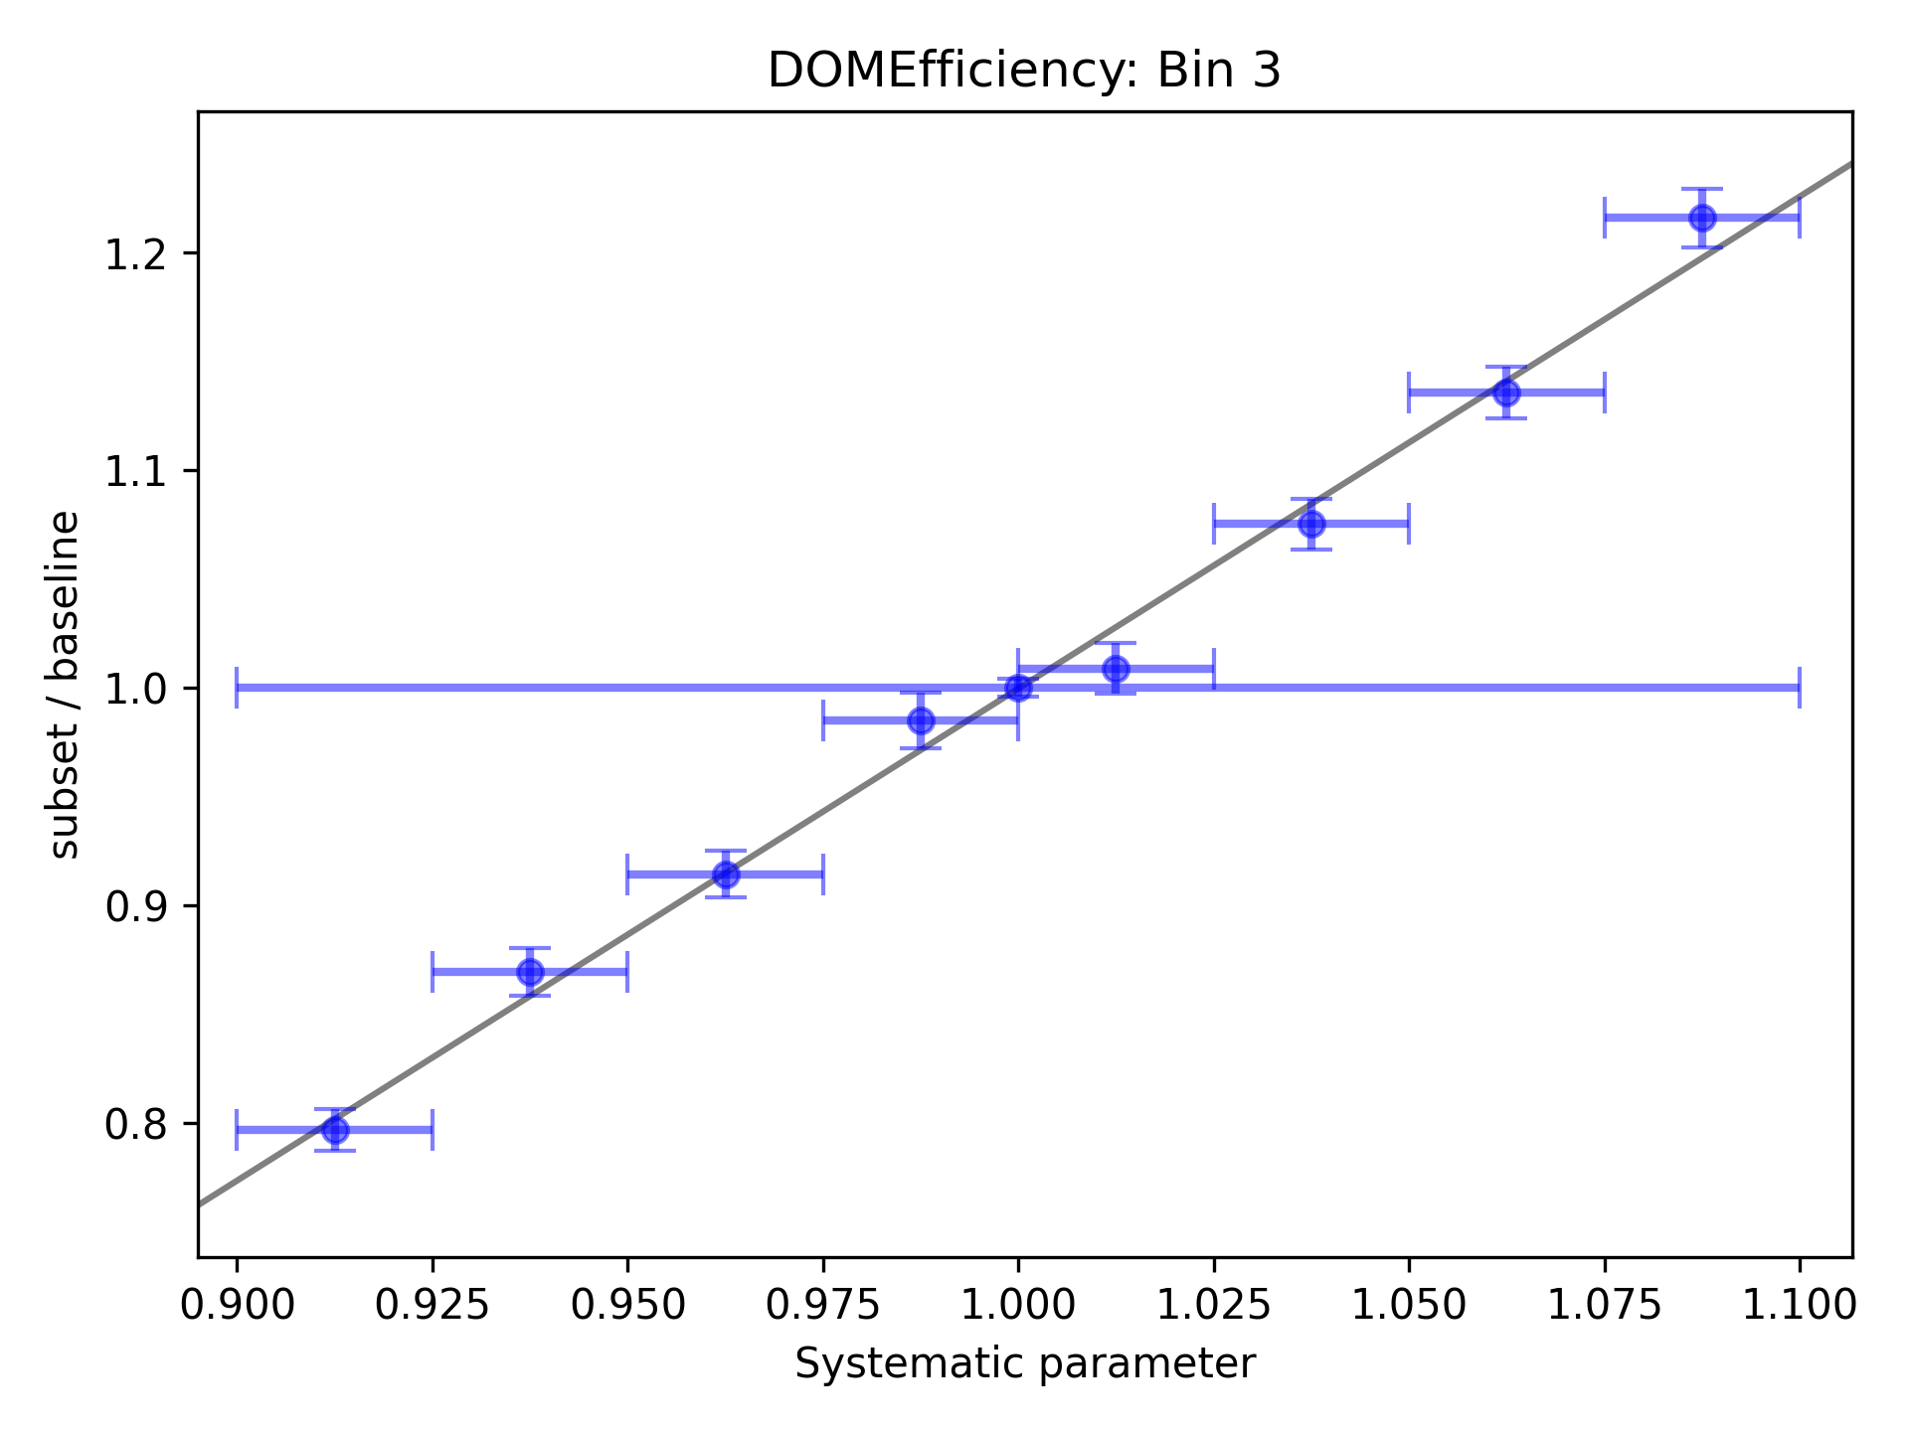
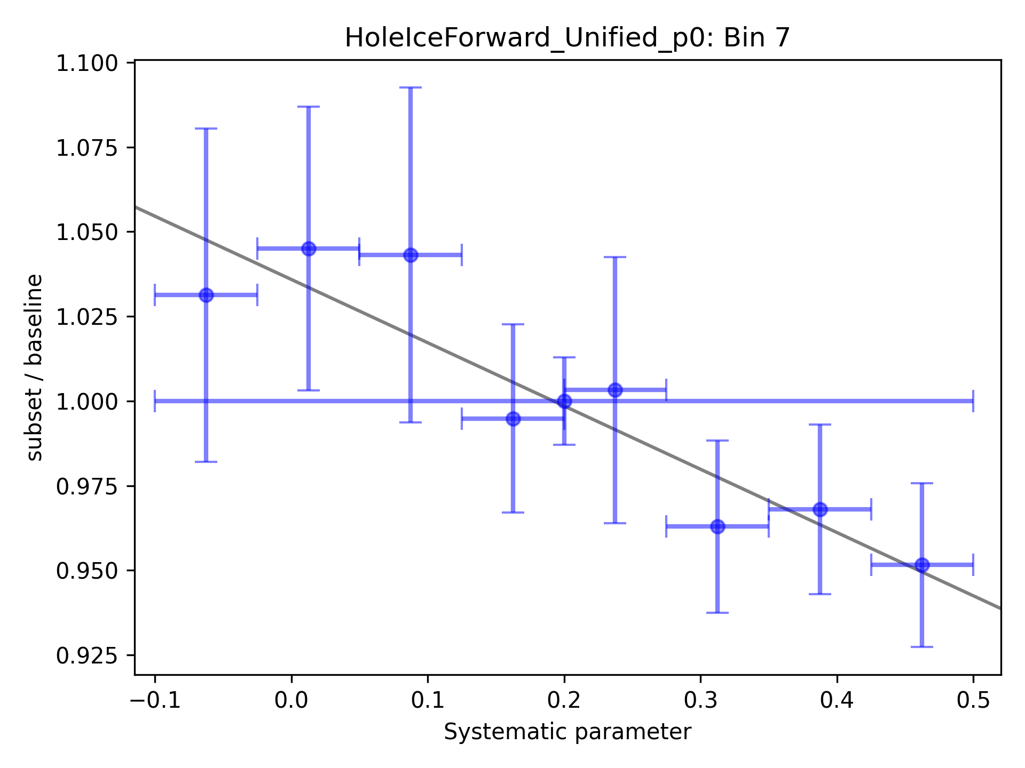
Fit ice systematics:
Parametrization for systematics in each proxy bin
Proxy: leading muon energy at entry
This is done for each systematic and every proxy bin

Slide 33
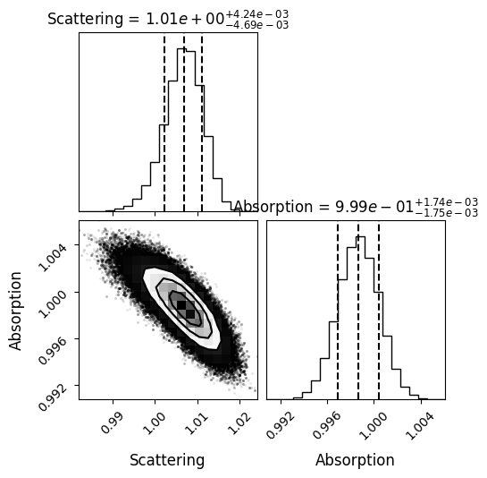
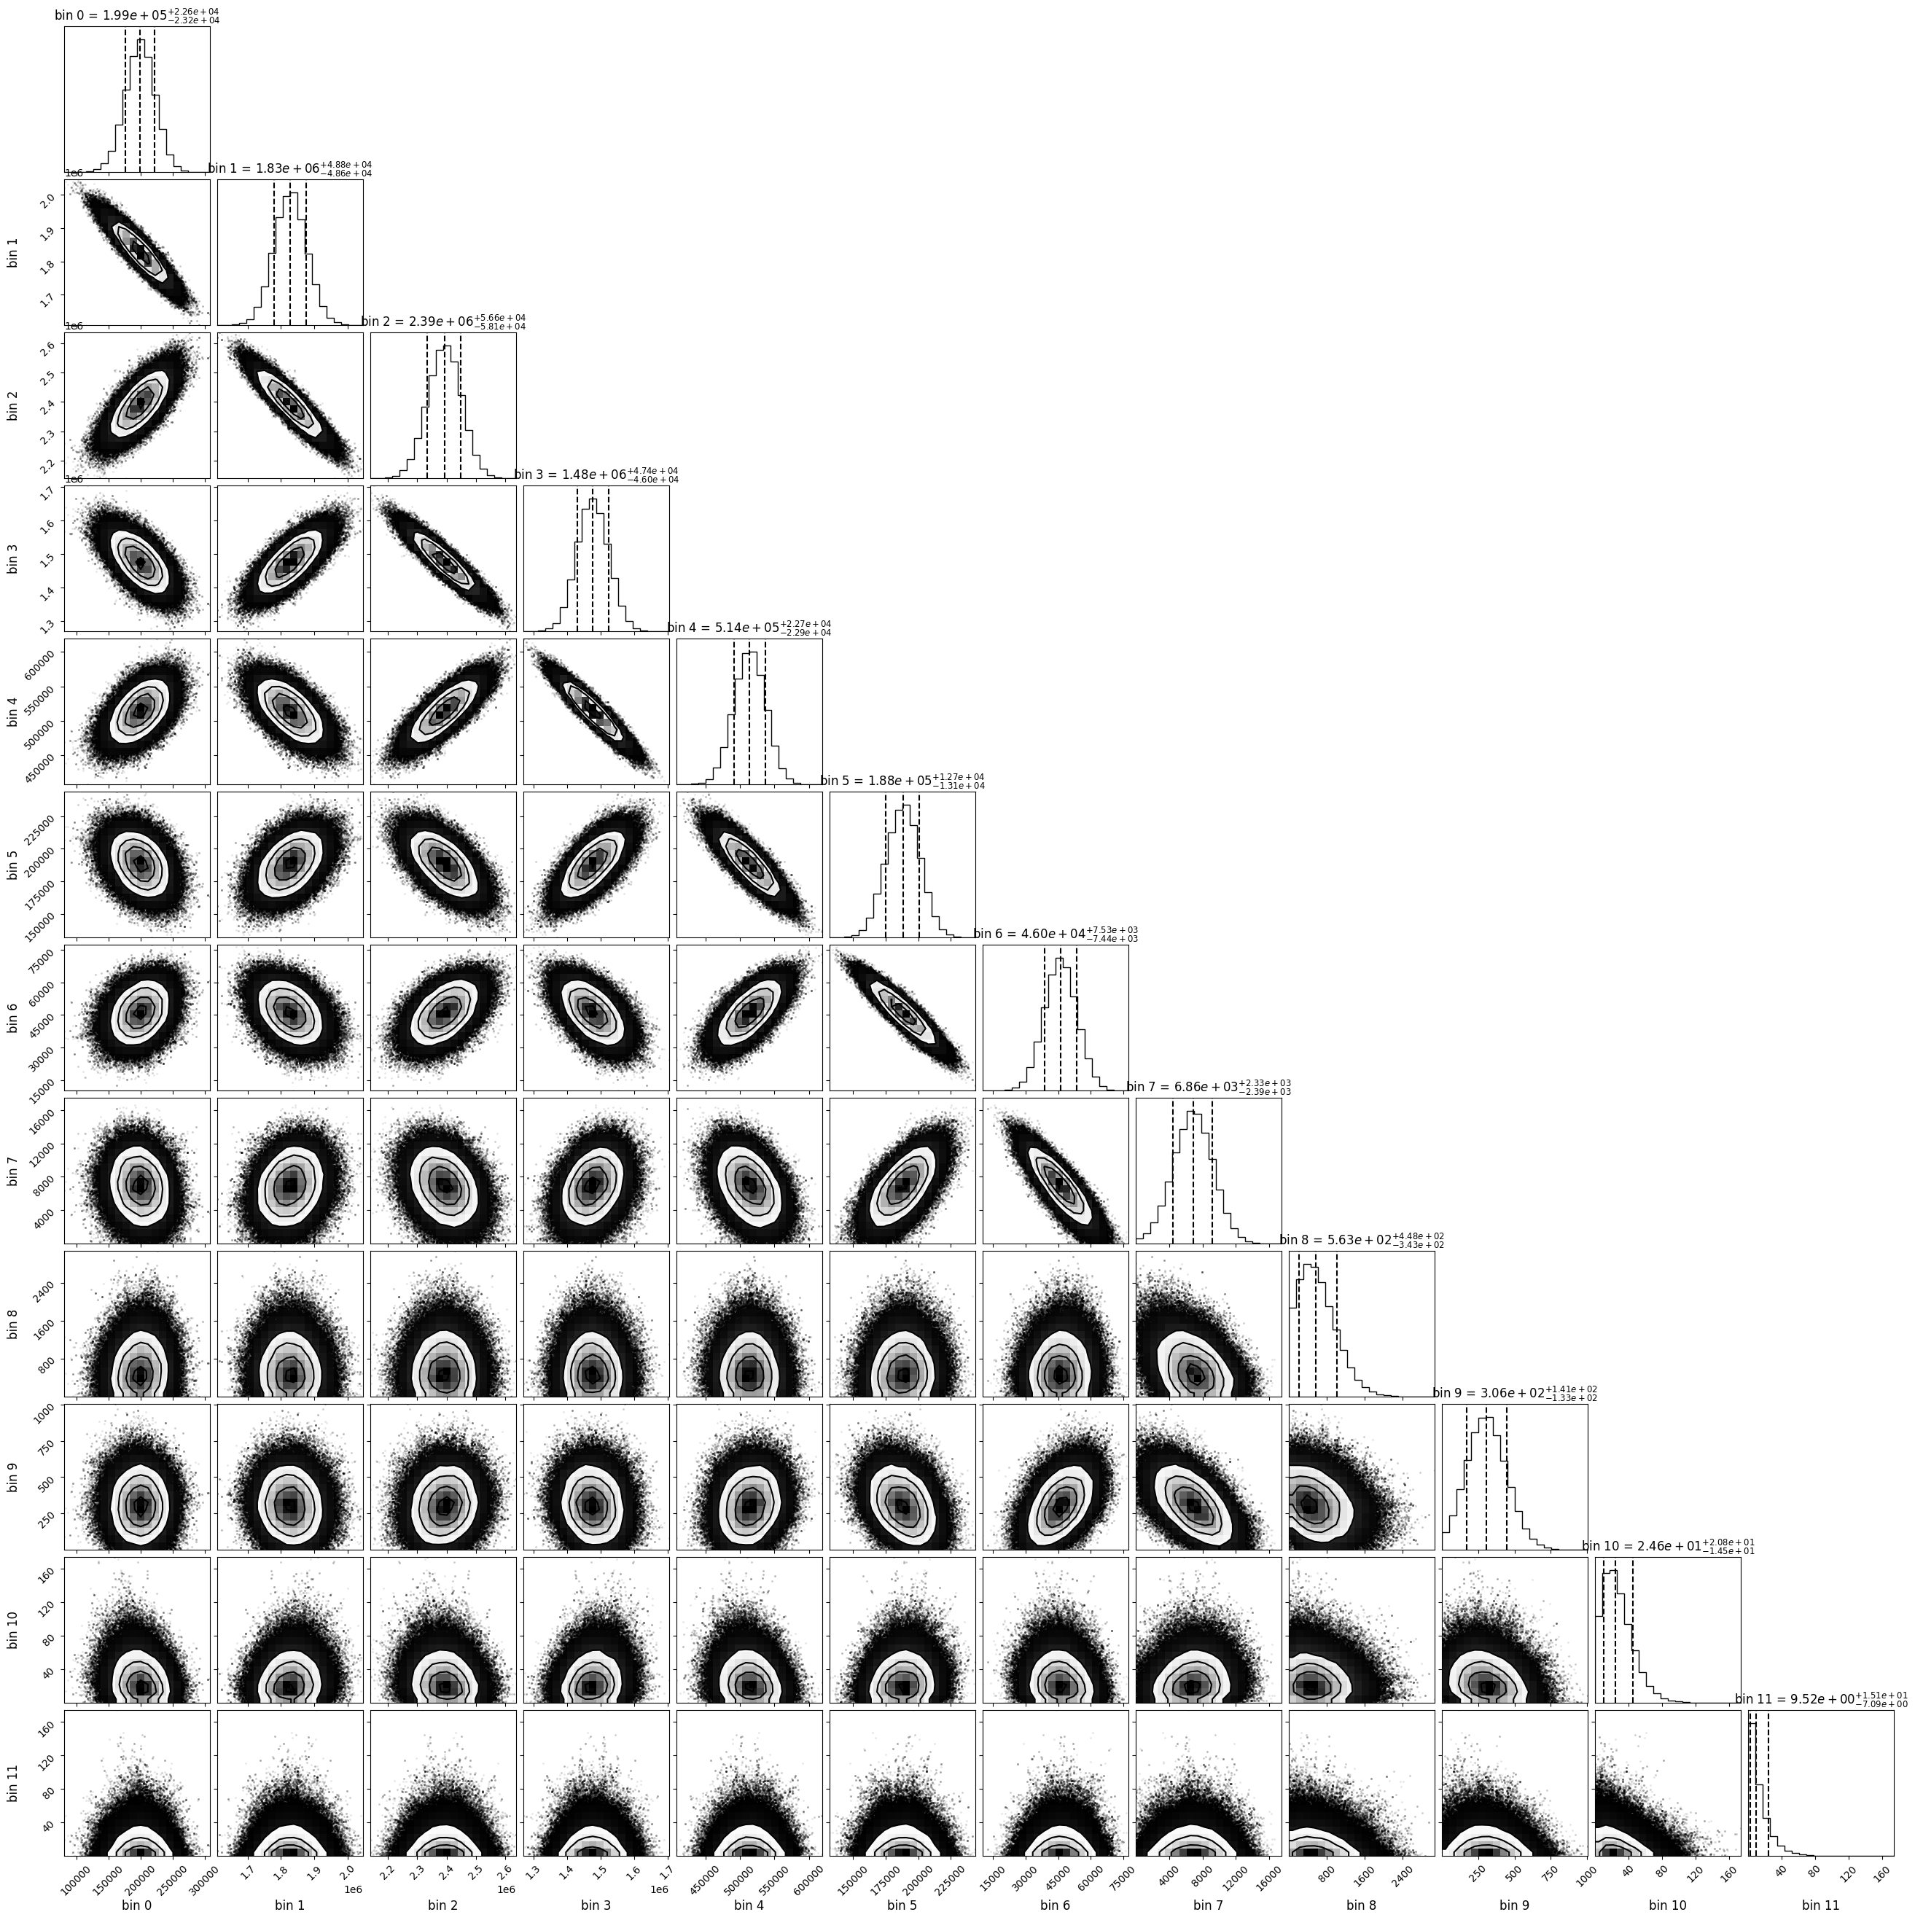
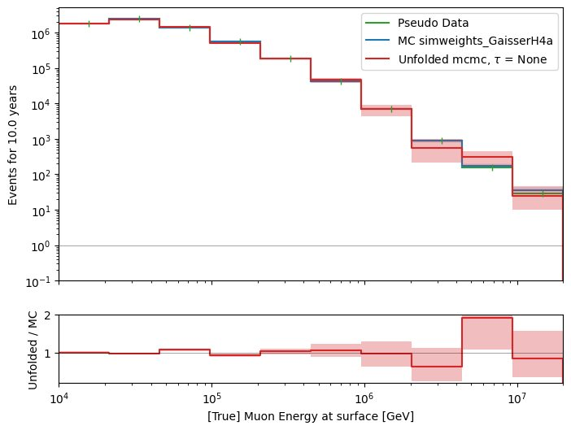
Unfolded event rate with systematics
work in progress
Use regularization to reduce unphyiscal oscillations

Slide 34
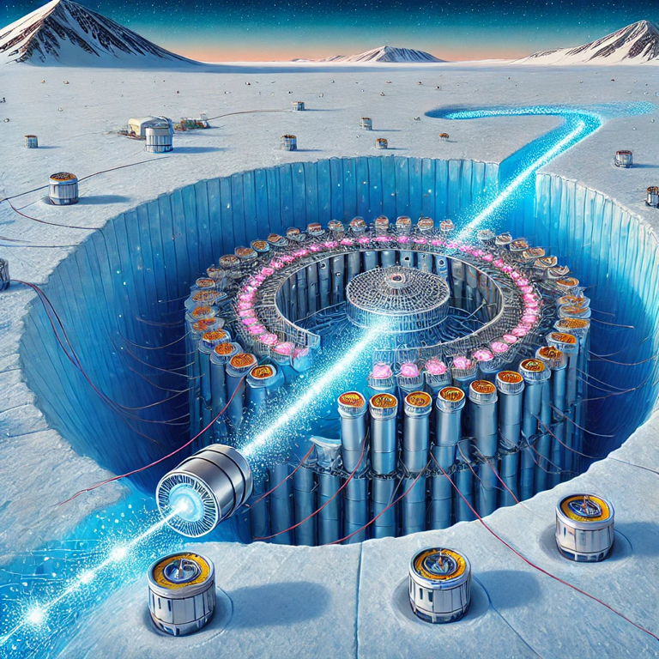
Conclusion & outlook
New CORSIKA simulations with parent information
tag prompt and conventional muons
validation: agreement with MCEq
Add DNN-based reconstructions
Good data-MC agreement
quality cuts defined
good agreement in cos(zenith) distributions
mismatch in z—position → re-weight distributions
Unfolding is set up
systematics can be included, minor investigations
Fit of prompt normalization is promising
systematics need to be included
How ChatGPT illustrates the detection of a prompt muon with IceCube.
Thank you for your attention!

Slide 35
Selection

Slide 36
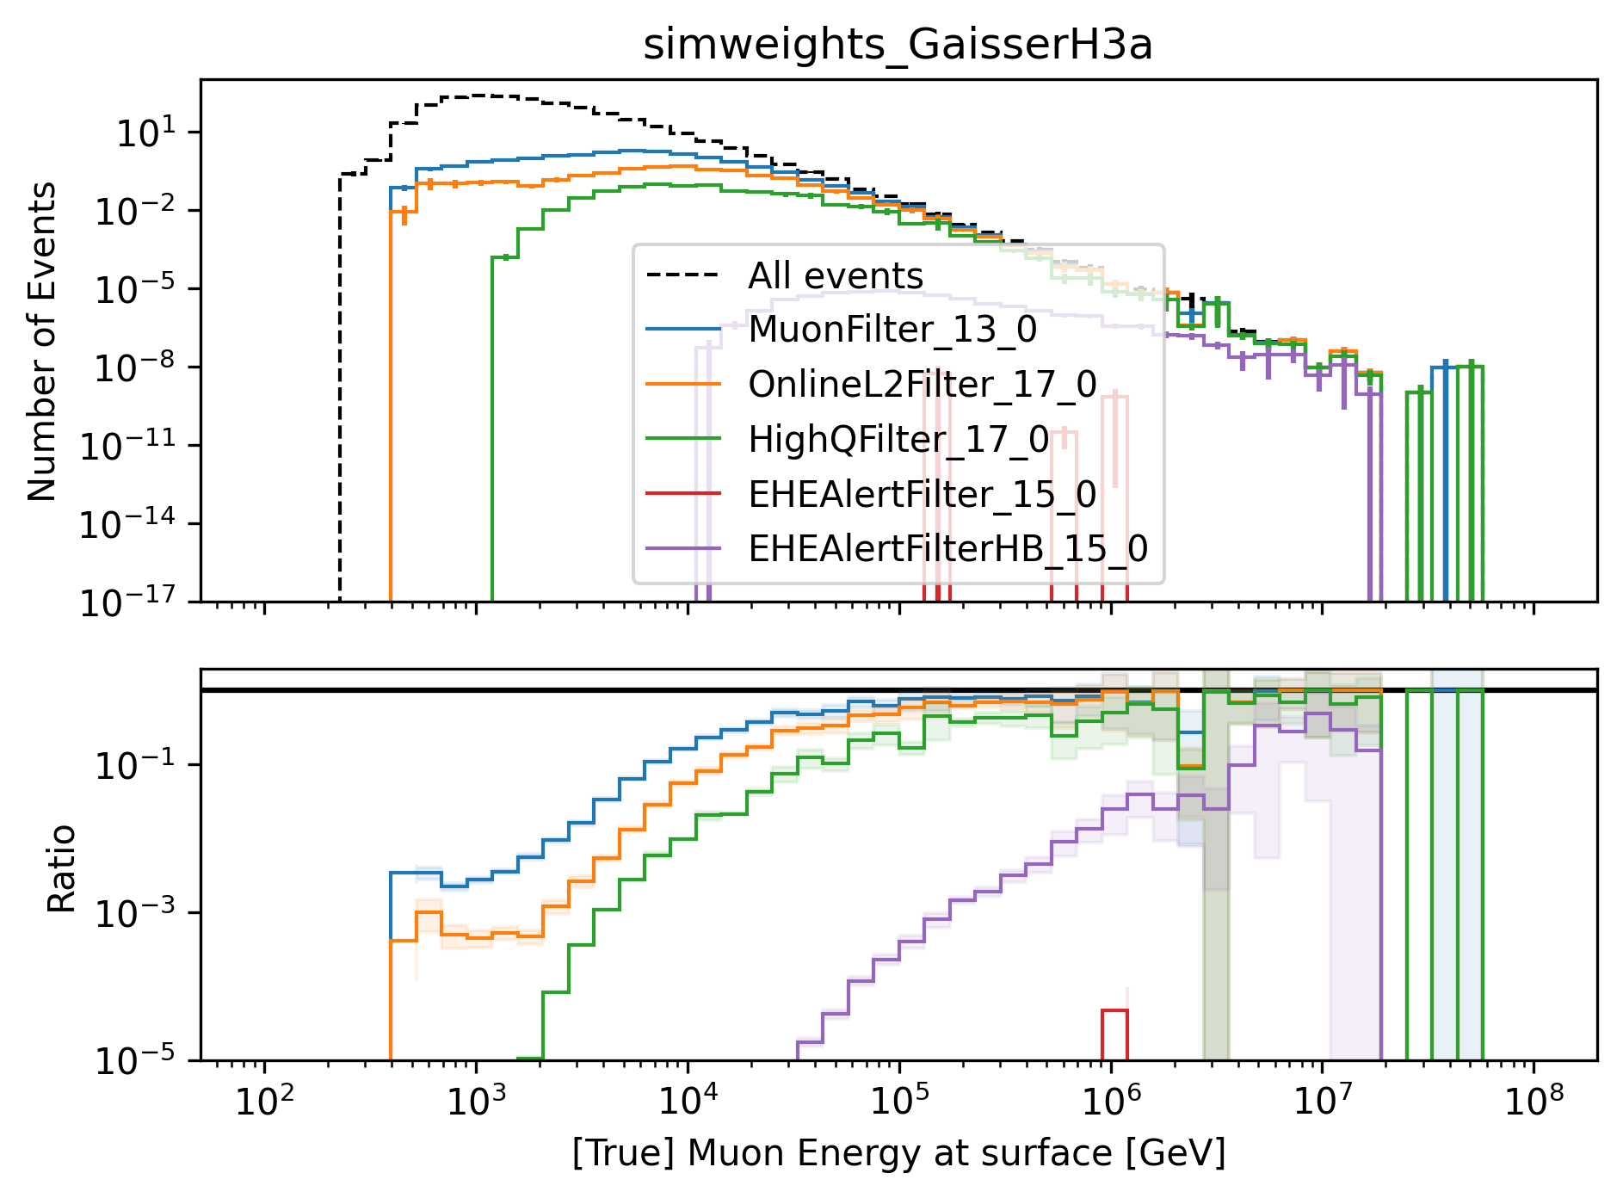
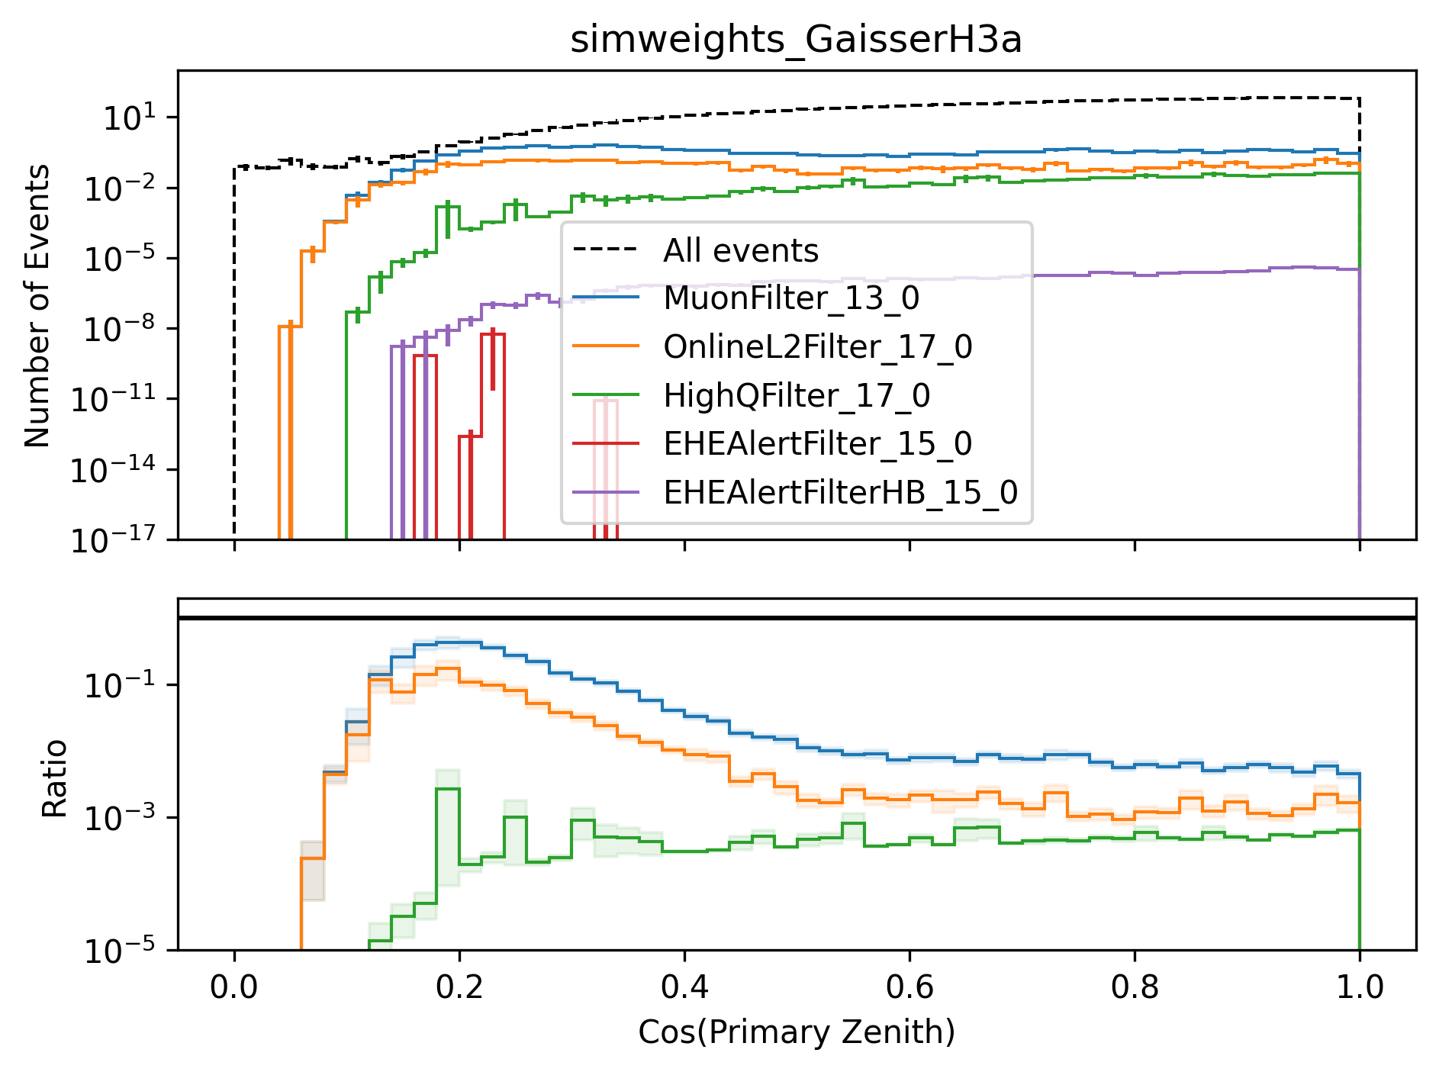
level3: muon filter
HighQFilter: removes more horizontal events → muons travel large distances, not enough energy left to pass high-charge filter
Goal: keep AMAP high-energy events at surface → muon filter
Notes:
muon filter checks for number of hit channels and charge for 3 different zones onlineL2filter also checks for hit channels, charge and 3 zones, but also a couple of more properties like multiplicity, direct hits and specific shapes in the Qtot distribution (kinks, slope)

Slide 37
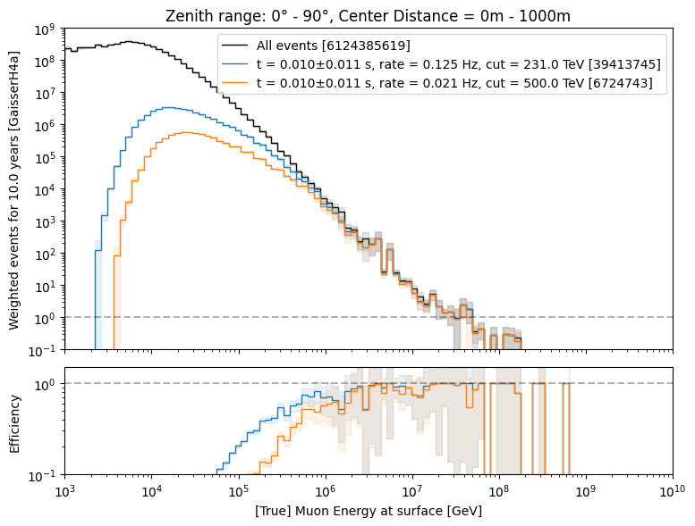
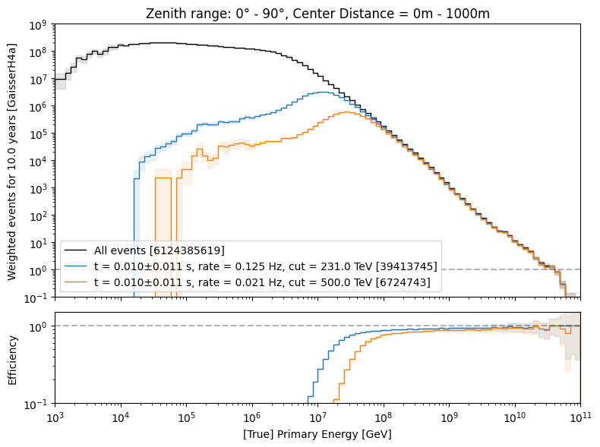
level3: 500 TeV bundle cut at surface
6 billion events expected: computationally not feasible → focus on high-energetic events
500 TeV cut: 6.7 Mio events left
use fast pre-cut network to estimate bundle energy at surface

Slide 38
Data-MC

Slide 39
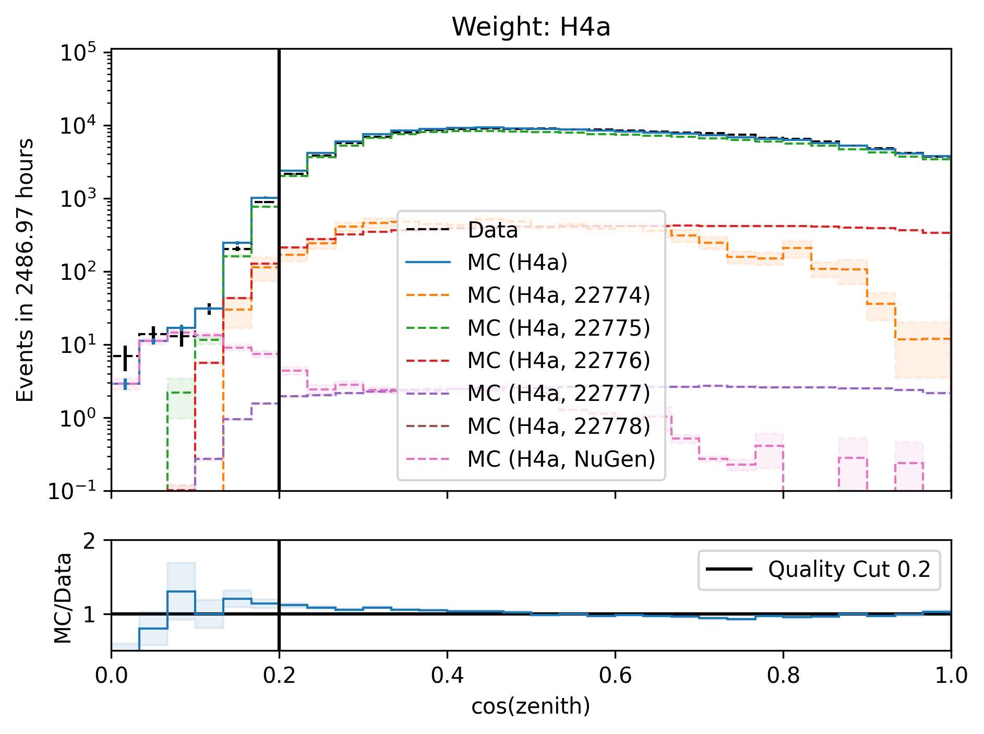
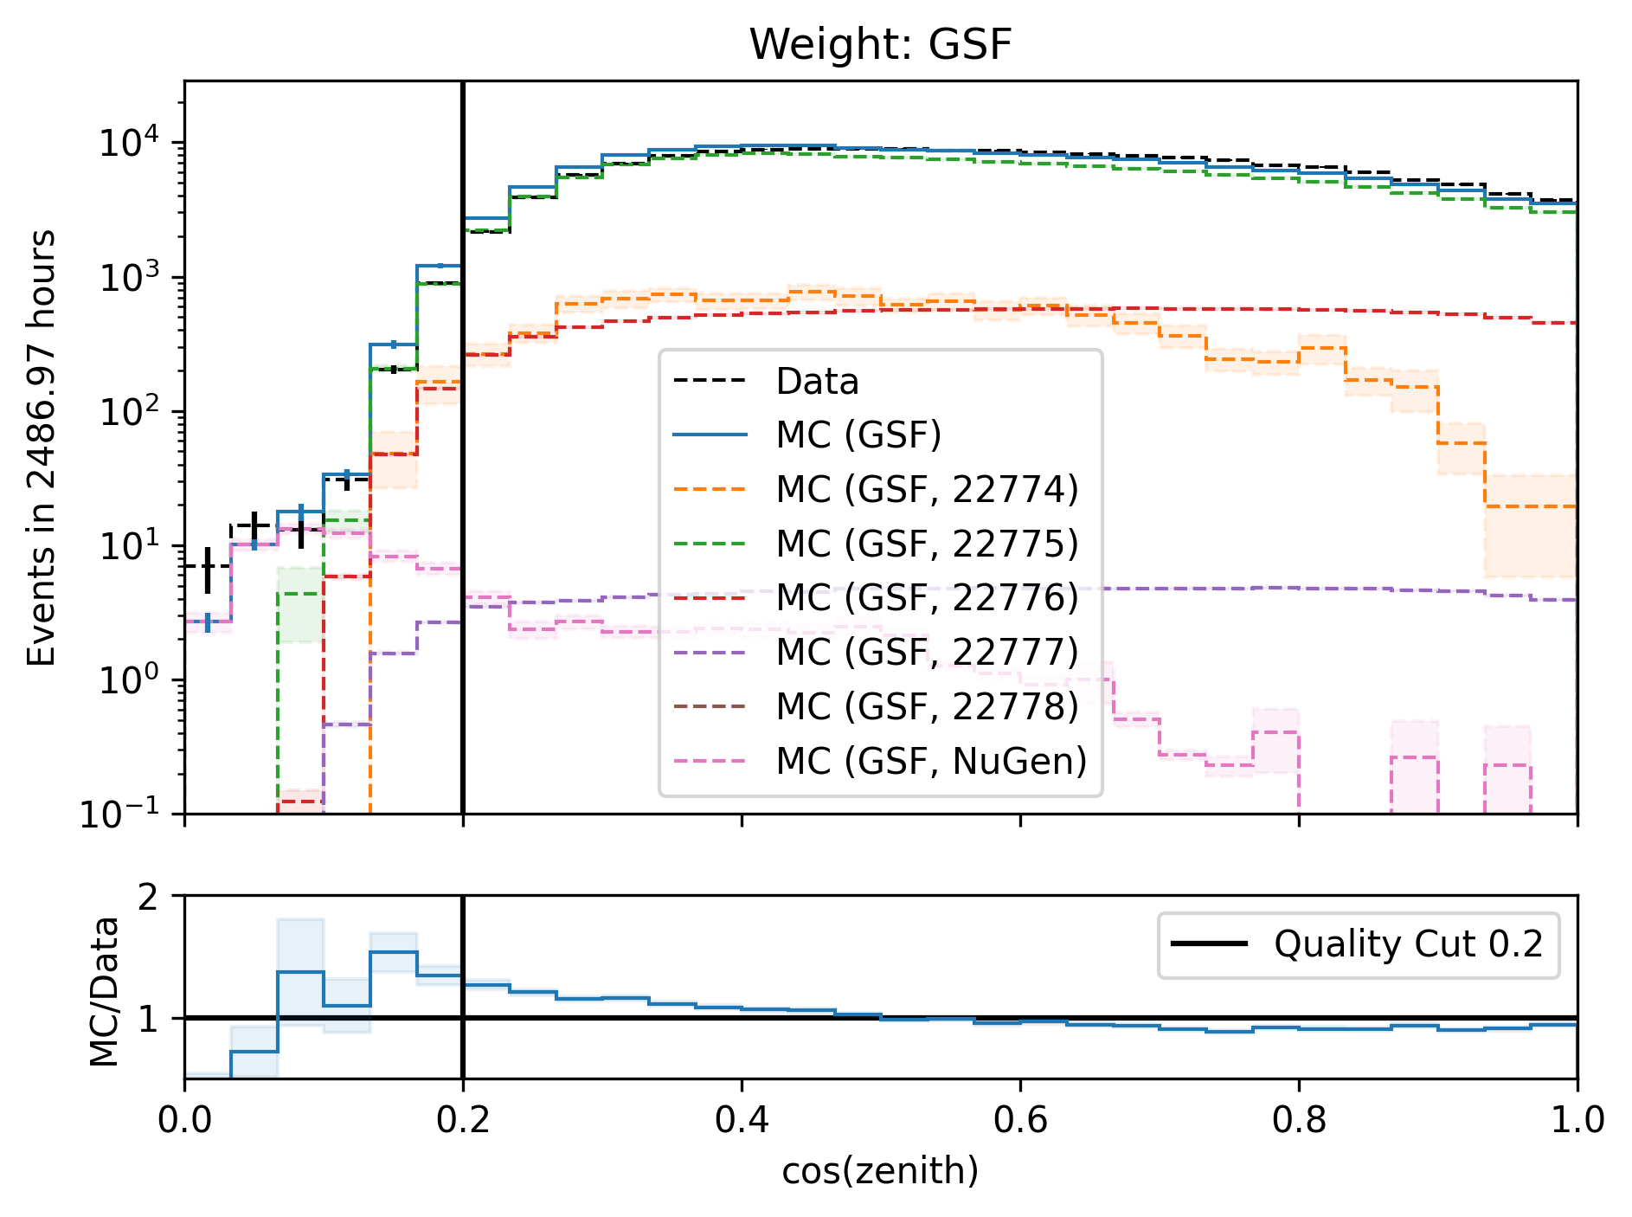
Cos(zenith)

Slide 40


Entry position z—vertex

Slide 41

z—reweighting
re-weight events to enforce a perfect agreement in the center z—position

Slide 42


Check z—reweighting
re-weighting has no large effect on cos(zenith) and energy

Slide 43
Level5: quality cuts
containment cuts | > | <
length in detector | 1000 m | 2000 m
entry pos x, y | -750 m | 750 m
entry pos z | -500 m | 750 m
center pos x, y | -550 m | 550 m
center pos z | -650 m | 650 m
uncertainty cuts | <
bundle energy at entry | 0.9 log10(GeV)
bundle energy at surface | 2.0 log10(GeV)
zenith | 0.1 rad
azimuth | 0.2 rad
entry pos x , y, z | 42 m
center pos x, y, z | 50 m
entry pos time | 200 ns
center pos time | 600 ns
length in detector | 160 m
length | 2000 m
neutrino cuts | > | <
cos(zenith) | 0.2
length | 5000 m | 15000 m

Slide 44


Level5: quality cuts → removes neutrinos
network learns: a high-energetic horizontal event in the detector needs a very high energy at surface

Slide 45
Rates per month
Data-MC

Slide 46


Rates per month
before quality cuts
after quality cuts
total offset in rate per month

Slide 47

Rates per month: scaled
Rates are scaled to the experimental rate to compare the shapes
Good agreement per month

Slide 48


unfolding of muon flux at surface – weighted to E^{3.7}
1 year
10 years

Slide 49


Muon flux
Most energetic muon in bundle
Muon parent:
pion or kaon
yes
no
$φ_{tot}=φ_{prompt}+$ $φ_{conventional}$
conventional
prompt
Credit: Ludwig Neste
Notes:
gamma = 2.7: SNR → fermi/shock acceleration, propagation of cosmic rays lead to interactions with galactic magnetic fields, interactions with gas, energy losses (ionization and nuclear interactions), in this process, some cosmic rays can escape the magnetic fields → this rate is energy dependent → higher-energtic cosmic rays escape more quickly → steepening of spectrum to ~2.7

Slide 50

Prompt atmospheric muons and neutrinos
10.1103/PhysRevD.100.103018
no unflavored
dominated by pions
dominated by kaons
Combined fit:
handle on pion/kaon ratio
handle on charmed mesons

Slide 51

Leading muon energy fraction
Solid: conventional
Dashed: prompt
Prompt dominates for energies > 1 PeV
Leading energy sweet spot: 0.1 – 0.9

Slide 52


Leading muon contribution
Patrick Berghaus
Muons with energies between 100 TeV and 50 PeV dominate the bundle by more than 90%
In average conventional muons are more dominant than prompt
But: at high energies, there are more prompt than conventional events
High leading energy fraction does not lead to more sensitivity to detect prompt

Slide 53




Muon puzzle and hadronic uncertainties
”muon number”
Expected z
(“muon number”)
2012
2108.08341
1208.1520
Uncertainties at E > 10 PeV
2020
More muons measured than simulated for E > 40 PeV ~ cms 8 TeV
2006.05012

Slide 54

The Muon Puzzle
”muon number”
2108.08341

Slide 55

Possible Solutions
Hans Dembinski

Slide 56

Simulation w/o coincident events
for primary energies above 1 TeV, using a time window of 6 µs, the chance for a coincident event is ≤ 1 %

Slide 57
Bundle energy cut
Rate after muon filter: 24.62 Hz
If the process of 1 event needs 1 second, 8h run takes 200h -> needs to be reduced!
Use small, fast network to remove low energy events -> target rate 125 mHz
CPU runtime: 11 ± 1ms
GPU
Network: precut_surface_bundle_energy_3inputs_6ms_01

Slide 58
Leading muon energy fraction - leadingness
True muon energy fraction is smeared
Network tries to predict the median of the distribution

Slide 59
Bundle energy at entry – 6 µs cleaned pulses
Median + 90% quantile
Prediction
True

Slide 60
Leading muon energy at entry – 6 µs cleaned pulses
Median + 90% quantile
Prediction
True

Slide 61
Bundle energy at surface – 6 µs cleaned pulses
Median + 90% quantile
Prediction
True

Slide 62
Leading muon energy at surface – 6 µs cleaned pulses
Median + 90% quantile
Prediction
True

Slide 63
Zenith – 6 ms cleaned pulses
Median + 90% quantile
Prediction
True

Slide 64
Azimuth – 6 ms cleaned pulses
Median + 90% quantile
Prediction
True

Slide 65
SplineMPE – DNN and conventional seeds
SplitInIceDSTPulsesTWCleaning6000ns

Slide 66
SplineMPE – DNN seeds
SplitInIceDSTPulsesTWCleaning6000ns
DNN contours

Slide 67


Level5: cos(zenith)

Slide 68


Proxy and target variable for unfolding – 10 years [H4a]

Slide 69

Unfolding with prompt and conv MCEq

Slide 70


Prompt and conv: muon energy at surface for 10 years

Slide 71


Compare all primary fluxes

Slide 72
Angular reconstructions: DNN vs. SplineMPE
DNN contours
DNN: ~6ms
Only small improvement at energies around 1 PeV
Countours are larger
Additional runtime
-> Use only DNN reconstruction, since we do not need the best angular resolution
Notes:
angular resolution: opening angle between true and reconstructed

Slide 73
Forward fit

Slide 74


Expected muons for 10 years: leading vs. bundle energy (GSF)
leading: energy of most energetic muon in a muon bundle
bundle: sum of energies of all muons of the bundle
L2 MuonFilter
L2 MuonFilter
Both leading and bundle energy are sensitive to detect prompt
Leading muon energy is more sensitive

Slide 75


Pseudo data sampling
Cuts:
L2 MuonFilter
Bundle energy at entry > 100 TeV
Tagging allows scaling of prompt by factor n_{pr}

Slide 76





Poisson likelihood fit performed in leading muon energy
Cuts:
L2 MuonFilter
Bundle energy at entry > 100 TeV
Test bias
Prompt scaling/normalization
MC counts per bin i
Conv norm = 1
Experimental counts
Maximize likelihood
With a constant conv norm:
bin counts depend only on prompt norm
= expectation value per bin
Easier:
minimize negative
log-likelihood
Test statistic for Wilks’ theorem
Bias starts at a prompt normalization of ~0.1
Null hypothesis: no prompt

Slide 77

Discovery potential and sensitivity
Cuts:
L2 MuonFilter
Bundle energy at entry > 100 TeV
Expectation for 1 year:
5 sigma discovery potential: 0.102 ± 0.005
Sensitivity: 0.024 ± 0.001
Expectation for 10 years:
5 sigma discovery potential: 0.032 ± 0.001
Sensitivity: 0.007 ± 0.000
Caution:
Limited MC statistics -> events are oversampled in pseudo dataset
No systematic uncertainties

Slide 78

Input data per DOM
10.1088/1748-0221/16/07/P07041
3 inputs
c_{total}: Total charge
Sum of charge
t_{first}: Relative time of first pulse
Relative to total time offset, calculated as the charge weighted mean time of all pulses
t_{std}: Standard deviation of first pulse
Charge weighted standard deviation of pulse times relative to total time offset
9 inputs
t_{last}: Relative time of last pulse
Relative to total time offset, calculated as the charge weighted mean time of all pulses
t_{20%}: Relative time of 20% charge
Relative to total time offset, calculated as the charge weighted mean time of all pulses
t_{50%}: Relative time of 50% charge
Relative to total time offset, calculated as the charge weighted mean time of all pulses
t_{mean}: Mean time
Charge weighted mean time of all pulses relative to total time offset
c_{500ns}: Charge at 500ns
Sum of charge after 500ns
c_{100ns}: Charge at 100ns
Sum of charge after 100ns
Input pulses
SplitInIceDSTPulses
SplitInIceDSTPulsesTWCleaning6000ns
(DNN framework performs an internal cleaning)
Training datasets
20904
21962
22020
22187

Slide 79




Air shower – 10 TeV
“muon bundles”
zeuthen.desy.de
Ralph Engel 2005
2211.16970v2
Proton
Iron
Notes:
shower maximum: x_max, slant depth at which the number of particles is the greatest, more energetic and lighter cosmic rays produce deeper/lower x_max, while heavier nuclei have a higher shower maximum
measure number of particles / muons
lateral spread
nitrogen can be excited → fluorescence light emitted
iron produces more muons than proton, because it has 56 nucleons → higher fragmentation → “sub-showers”

Slide 80
Agreement for different primary models

Slide 81


Azimuth

Slide 82


Bundle energy at entry

Slide 83


Leading muon energy at entry

Slide 84


Entry position x–vertex

Slide 85


Entry position y–vertex

Slide 86
DNN reconstructions

Slide 87
Reconstructed properties
Energy
entry_energy: Leading muon energy at the detector entry
bundle_energy_at_entry: Muon bundle energy at the detector entry
muon_energy_first_mctree: Leading muon energy at surface
bundle_energy_in_mctree: Muon bundle energy at surface
Track geometry
Length: Propagation length of muon in the ice
LengthInDetector: Propagation length of muon in the detector
center_pos_x: Closest x position of muon to center of the detector
center_pos_y: Closest y position of muon to center of the detector
center_pos_z: Closest z position of muon to center of the detector
center_pos_t: Time of closest approach to the center of the detector
entry_pos_x: x position of muon at the detector entry
entry_pos_y: y position of muon at the detector entry
entry_pos_z: z position of muon at the detector entry
entry_pos_t: Time of muon at the detector entry
Direction
zenith: Zenith angle of muon
azimuth: Azimuth angle of muon
Network 1
Network 0: Muon bundle energy at surface (fast pre-cut)
Network 2
Network 3

Slide 88


Muon flux: Prompt spectrum
$φ_{tot}=φ_{prompt}+$ $φ_{conventional}$
0°: perpendicular to Earth’s surface
Most energetic muon in bundle
conventional
prompt
Muon parent:
pion or kaon
yes
no
conventional
prompt

Slide 89


Neutrino: z-vertex
Dissertation Mirco
Same shape mismatch for neutrinos as for muons

Slide 90
Stopping muons

Slide 91




Entry position z - different cos(zenith)

Slide 92




Entry position z - different cuts on bundle energy at surface

Slide 93
New CORSIKA simulation
with extended history option for information about the parent particles

Slide 94
CORSIKA 7 tagging and MCEq comparison
MCEq: tool to numerically solve the cascade equations that describes the evolution of particle densities as they propagate through a gaseous, dense medium
https://github.com/mceq-project/MCEq
GSF weighting
GSF weighting
Good agreement in total prompt and conv muon flux
D⁰ and D_{s} are swapped here but this is fixed in MCEq

Slide 95


Astroparticle physics
gallery.icecube.wisc.edu
Credit: IceCube / NSF

Slide 96

Cosmic ray flux
1903.07713
Notes:
1. Knee: ~3 PeV, before gamma = 2.7, limit of acceleration mechanism for cosmic rays in supernova remnants 2. Knee: ~100 PeV, before gamma = 3.1, heavier elements, like iron, from galactic sources start to reach their maximum acceleration energy → more protons, larger energy in electromagnetic acceleration Ankle: ~1 EeV, flattens out again, transition point between galactic and extra galactic particle origin,

